Slide 1


School Lunch Procurement
and Using Geographic Preference
2011 NC DPI
CN Directors Meeting
October 20, 2011
Raleigh, NC
Kirk Farquharson
Senior Program Specialist
USDA Food and Nutrition Service
Southeast Regional Office

Slide 2
Overview
Federal Regulations are the litmus paper.
  Federal versus State or local procurement rules.
School nutrition programs must follow specific methods of procurement for the NSLP/SBP.
Purchasing locally produced farm products (Geographic Preference).
Writing Specifications.

Slide 3
Applicable Federal Regulations
7 CFR 3016 UNIFORM ADMINISTRATIVE REQUIREMENTS FOR GRANTS AND COOPERATIVE AGREEMENTS TO STATE AND LOCAL GOVERNMENTS
7 CFR 3019 UNIFORM ADMINISTRATIVE REQUIREMENTS FOR GRANTS AND AGREEMENTS WITH INSTITUTIONS OF HIGHER EDUCATION, HOSPITALS, AND OTHER NON-PROFIT ORGANIZATIONS
7 CFR 210 NATIONAL SCHOOL LUNCH PROGRAM
7 CFR 220 SCHOOL BREAKFAST PROGRAM

Slide 4
Federal Regulations
7 CFR 3016.36
  3016.36(b) Procurement standards. (1) Grantees and subgrantees (State agency (NC DPI)and School Districts)will use their own procurement procedures which reflect applicable State and local laws and regulations, provided that the procurements conform to applicable Federal law and the standards identified in this section.

Slide 5
School Nutrition Program Procurement
7 CFR part 210.21 and 7 CFR 220.16
  State agencies and school food authorities shall comply with the requirements of this part and 7 CFR part 3016 or 7 CFR part 3019, as applicable, which implement the applicable Office of Management and Budget Circulars, concerning the procurement of all goods and services with nonprofit school food service account funds.

Slide 6
School Nutrition Program Procurement
7 CFR 210.21(c):
  The State agency may elect to follow either the State laws, policies and procedures or the procurement standards for other governmental grantees.
  A school food authority may use its own procurement procedures which reflect applicable State and local laws and regulations, provided that procurements made with nonprofit school food service account funds adhere to the standards set forth in this part and §§3016.36(b) through 3016.36(i), 3016.60 and 3019.40 through 3019.48 of this title, as applicable, and in the applicable Office of Management and Budget Circulars. School food authority procedures must include a written code of standards of conduct meeting the minimum standards of §3016.36(b)(3) or §3019.42 of this title, as applicable.

Slide 7
What Procurement Processes Must School Nutrition Programs Follow?
Full and Open Competition,
Use local procurement rules and use the following methods:
  Methods of Procurement
    Small Purchase Procedures or Simple/Informal Procurement
    Sealed Bids or Formal Advertising
    Competitive Proposal or Request for Proposal (RFP)
    Non Competitive Negotiations

Slide 8
Full and Open Competition
3016.36(c)
  All procurement transactions will be conducted in a manner providing full and open competition consistent with the standards of §3016.36. Some of the situations considered to be restrictive of competition include but are not limited to:
    (i) Placing unreasonable requirements on firms in order for them to qualify to do business,
    (ii) Requiring unnecessary experience and excessive bonding,

Slide 9
Full and Open Competition
    (iii) Noncompetitive pricing practices between firms or between affiliated companies, (collusion)
    (iv) Noncompetitive awards to consultants that are on retainer contracts,
    (v) Organizational conflicts of interest,
    (vi) Specifying only a “brand name” product instead of allowing “an equal” product to be offered and describing the performance of other relevant requirements of the procurement, and
    (vii) Any arbitrary action in the procurement process.

Slide 10
Full and Open Competition
    (2) Grantees and subgrantees will conduct procurements in a manner that prohibits the use of statutorily or administratively imposed in-State or local geographical preferences in the evaluation of bids or proposals, except in those cases where applicable Federal statutes expressly mandate or encourage geographic preference. (FNS does allow Geographic Preference for unprocessed locally grown or locally raised agricultural products.)

Slide 11
Local rule
  7 CFR 210.21(c): A school food authority may use its own procurement procedures which reflect applicable State and local laws and regulations, provided that procurements made with nonprofit school food service account funds adhere to the standards set forth in this part and §§3016.36(b) through 3016.36(i), 3016.60 and 3019.40 through 3019.48 of this title, as applicable, and in the applicable Office of Management and Budget Circulars. School food authority procedures must include a written code of standards of conduct meeting the minimum standards of §3016.36(b)(3) or §3019.42 of this title, as applicable.

Slide 12

Methods of Procurement
Four (4) allowed methods:
Simplified Acquisition – Small purchase procedures or simple/informal procurement
Sealed Bids/Formal Advertising
Competitive Proposals
Noncompetitive Proposals

Slide 13
Methods of Procurement
  Simplified Acquisition/Small Purchase Procedures or Simple/Informal Procurement 3016.36(d)(1)
  Small purchase procedures are those relatively simple and informal procurement methods for securing services, supplies, or other property that do not cost more than the simplified acquisition threshold [SAT] fixed at 41 U.S.C. 403(11) [currently the Federal SAT is set at $100,000. Some local SAT are as low as $5,000]. If small purchase procedures are used, price or rate quotations shall be obtained from an adequate number of qualified sources. (FNS recommends three or more qualified sources.)

Slide 14
Simplified Acquisition:
1
Develop your specs in writing
Identify sources eligible, able, and willing to provide products
Contact at least three of those sources
Evaluate bidders’ response to your specs
Determine most responsive and responsible bidder at lowest price
5
2
3
4

Slide 15
Methods of Procurement
Sealed Bids /Formal Advertising 3016.36(d)(2)
  Procurement by sealed bids (formal advertising)bids are publicly solicited and a firm-fixed-price contract (lump sum or unit price) is awarded to the responsible bidder whose bid, conforming with all the material terms and conditions of the invitation for bids, is the lowest in price.

Slide 16
Methods of Procurement
Sealed Bid/formal Advertising
  (i) In order for sealed bidding to be feasible, the following conditions should be present:
    (A) A complete, adequate, and realistic specification or purchase description is available;
    (B) Two or more responsible bidders are willing and able to compete effectively and for the business; and
    (C) The procurement lends itself to a firm fixed price contract and the selection of the successful bidder can be made principally on the basis of price.
Produce Bid

Slide 17
Methods of Procurement
Sealed Bid/formal Advertising
  (ii) If sealed bids are used, the following requirements apply:
    (A) The invitation for bids will be publicly advertised and bids shall be solicited from an adequate number of known suppliers, providing them sufficient time prior to the date set for opening the bids;
    (B) The invitation for bids, which will include any specifications and pertinent attachments, shall define the items or services in order for the bidder to properly respond;

Slide 18
Methods of Procurement
Sealed Bid/formal Advertising
      (C) All bids will be publicly opened at the time and place prescribed in the invitation for bids;
      (D) A firm fixed-price contract award will be made in writing to the lowest responsive and responsible bidder. Where specified in bidding documents, factors such as discounts, transportation cost, and life cycle costs shall be considered in determining which bid is lowest. Payment discounts will only be used to determine the low bid when prior experience indicates that such discounts are usually taken advantage of; and
    E) Any or all bids may be rejected if there is a sound documented reason.

Slide 19
Formal Procurement:
1
Develop solicitation
Publicly announce the IFB/RFP
Evaluate bidders using established criteria
Determine most responsive and responsible bidder at lowest price.
Award and Manage Contract
5
2
4
3

Slide 20
Methods of Procurement
Competitive Proposals/Request for Proposals (RFP) 3016.36(d)(3)
  The technique of competitive proposals is normally conducted with more than one source submitting an offer, and either a fixed-price or cost-reimbursement type contract is awarded. It is generally used when conditions are not appropriate for the use of sealed bids. If this method is used, the following requirements apply:
    (i) Requests for proposals will be publicized and identify all evaluation factors and their relative importance. Any response to publicized requests for proposals shall be honored to the maximum extent practical;

Slide 21
Methods of Procurement
Competitive Proposals (RFP)
    (iv) Awards will be made to the responsible firm whose proposal is most advantageous to the program, with price and other factors considered;

Slide 22
Competitive Procurement:
1
Develop solicitation: Product/service expectations, evaluation criteria, etc.
Publicly announce the RFP
Receive, Evaluate bidders using established criteria
Determine most responsive and responsible bidder at lowest price and/or highest scoring proposal
Award and Manage Contract
5
2
4
3

Slide 23
Methods of Procurement
Noncompetitive Proposals 3016.36 (d)(4)
  Procurement through solicitation of a proposal from only one source, or after solicitation of a number of sources, competition is determined inadequate.
    (i) Procurement by noncompetitive proposals may be used only when the award of a contract is infeasible under small purchase procedures, sealed bids or competitive proposals and one of the following circumstances applies:
      (A) The item is available only from a single source;
      (B) The public exigency or emergency for the requirement will not permit a delay resulting from competitive solicitation;

Slide 24
Methods of Procurement
Noncompetitive Proposals
      (C) The awarding agency authorizes noncompetitive proposals; or
      (D) After solicitation of a number of sources, competition is determined inadequate.
        (ii) Cost analysis, i.e. , verifying the proposed cost data, the projections of the data, and the evaluation of the specific elements of costs and profits, is required.
        (iii) Grantees and subgrantees may be required to submit the proposed procurement to the awarding agency for pre-award review in accordance with paragraph (g) of this section.

Slide 25
Geographic Preference
7 CFR 210.21(g) and 7 CFR 220.16(f)
  Geographic preference. (1) A school food authority participating in the Program, as well as State agencies making purchases on behalf of such school food authorities, may apply a geographic preference when procuring unprocessed locally grown or locally raised agricultural products. When utilizing the geographic preference to procure such products, the school food authority making the purchase or the State agency making purchases on behalf of such school food authorities have the discretion to determine the local area to which the geographic preference option will be applied;

Slide 26

Geographic Preference
    (ii) Proposals will be solicited from an adequate number of qualified sources;
    (iii) Grantees and subgrantees will have a method for conducting technical evaluations of the proposals received and for selecting awardees;

Slide 27
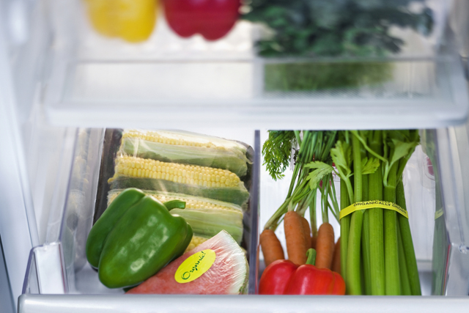
Geographic Preference
  (2) For the purpose of applying the optional geographic procurement preference in paragraph (g)(1) of this section, ‘‘unprocessed locally grown or locally raised agricultural products’’ means only those agricultural products that retain their inherent character.

Slide 28

Geographic Preference
        The effects of the following food handling and preservation techniques shall not be considered as changing an agricultural product into a product of a different kind or character: Cooling; refrigerating; freezing; size adjustment made by peeling, slicing, dicing, cutting, chopping, shucking, and grinding; forming ground products into patties without any additives or fillers;

Slide 29
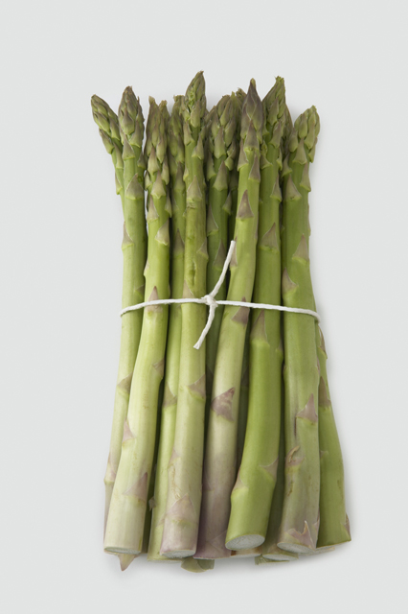
Geographic Preference
      drying/ dehydration; washing; packaging (such as placing eggs in cartons), vacuum packing and bagging (such as placing vegetables in bags or combining two or more types of vegetables or fruits in a single package); the addition of ascorbic acid or other preservatives to prevent oxidation of produce; butchering livestock and poultry; cleaning fish; and the pasteurization of milk.

Slide 30

Geographic Preference
Unallowable food handling and preservation techniques
  Heating/canning -- the inherent character of the product is not retained because the heating process involved in canning changes the agricultural product into a product of a different kind or character

Slide 31
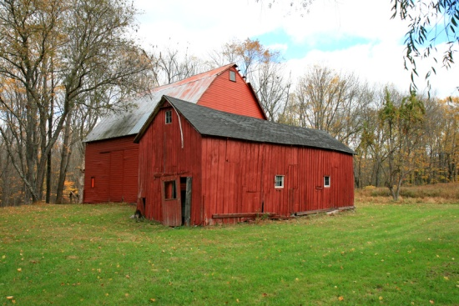
Geographic Preference
What is Local?
  Discretion to define the local area for any geographic preference is left to the institution responsible for procurement
  “Local” must not be defined in a way that unnecessarily limits competition
  Bottom line: Reduce the carbon foot print of the cost of procuring locally grown or locally raised agricultural products.

Slide 32

Developing Product Specifications
The key to effective purchasing of local food items requires the school food authorities (SFA) to take some important steps before they actually begin the procurement process. Before purchasing for the Child Nutrition Programs, the SFA must evaluate their current food service operations and needs; this is also known as forecasting.

Slide 33

Conducting a Self-Assessment
In conducting a self-assessment the SFA should consider food service operations that relate to their:
  Operational practices – self-operating or contracted with a Food Service Management Company;
  Kitchen facilities – central kitchen, individual kitchen sites, or combination;
  Storage capacity;
  Processing abilities;
  Staff resources;
  Food safety practices;
  Prior year’s menus; and
  Current food inventory.

Slide 34
Evaluating Current FS Needs
SFAs should also evaluate their current food service needs, such as:
  Necessary food volume;
  Student preferences;
  Menu requirements; and
  Required transportation and delivery needs.

Slide 35
Developing Specifications
SFAs should think carefully about developing specifications that reflect the specific characteristics of the products they seek. The following examples are indicators that may be used within a product’s specification:
  Degree of ripeness or maturity;
  Condition upon receipt of product;
  Age of product;
  Weight range;
  Preservation or processing method;
  US Standard for Grade; and
  Temperature during delivery and upon receipt.

Slide 36


Developing Specifications
There are important elements to consider when drafting specification for local food items. Elements such as: size, quantity, quality, cleanliness, packaging, food safety and delivery. Consult USDA resources such as the Food Buying Guide for Child Nutrition Programs and Fruits and Vegetables Galore to aid in the development of product specifications.

Slide 37
Developing Specifications
Although not all-encompassing, the examples below provide some specification elements that are important factors to discuss with local producers to ensure that expectations and requirements are clear:
Specification Elements Examples:
  Size: Indicate the size an apple must be to qualify as part of a reimbursable meal, so that expectations are set up front.
  Quantity: Farmers and SFAs sometimes speak different languages—schools may not be used to ordering apples in “bushels” from their national distributor; be aware of language barriers.
  Quality: Indicate that lettuce must be a healthy green color with no brown leaves.

Slide 38
Developing Specifications
  Specification Elements Examples (con’t):
  Cleanliness: Indicate that lettuce should be clean with no visible signs of dirt or insects.
  Packaging: A local farmer may sell product in 25 pound boxes, but the SFA may need lighter/smaller packaging in order for staff to carry.
  Food Safety: Include a checklist of questions for the farmer to complete regarding their agricultural practices (consult our Food Safety webpage for more information
  Delivery: Establish a delivery day and time for products.

Slide 39
Where do I find this guidance?
http://www.fns.usda.gov/cnd/governance/regulations.htm
http://www.fns.usda.gov/cnd/F2S/f2spolicy.htm
Lynn Harvey, Section Chief, NC DPI
Child Nutrition Services Section
(919) 807-3506; Lynn.Harvey@dpi.nc.gov
Kirk Farquharson
SERO Farm to School Coordinator
USDA Food and Nutrition Service, Southeast Regional Office
(404) 562-7084
Kirk.Farquharson@fns.usda.gov

