Slide 1

Cervid Chronic Wasting Disease Surveillance and Identification (CCWDSI)
Program Training
by Chris Hinkle
Office of State Veterinarian (OSV)
Kentucky Department of Agriculture

Slide 2
Training Requirement
This training meets the requirements of the Kentucky farmed cervid regulations.
This training is required for all farmed cervid producers currently enrolled in the program as of 2021
This training will be required for all farmed cervid producers entering the program after 2021.

Slide 3
Overview
Chronic Wasting Disease (CWD)
Signs of CWD
Current mapping of CWD
CCWDSI Program Information

Slide 4
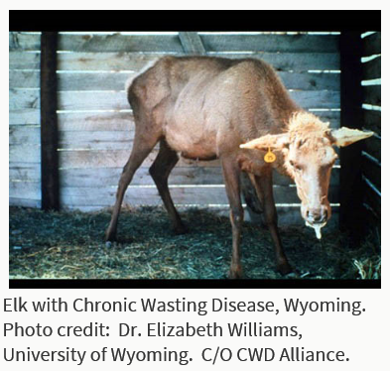
What is CWD?
Chronic Wasting Disease (CWD) - contagious neurological disease affecting species of the Cervidae family.
  causes a spongy degeneration of the brain of infected animals
  results in emaciation, abnormal behavior, loss of bodily functions
  ALWAYS FATAL
5 species of the deer family are known to be naturally susceptible to CWD:
  elk, mule deer, white-tailed deer, black-tailed deer and moose.
Several subspecies of deer around the globe have also contracted CWD.
Susceptibility of other members of the deer family (cervids) and other species is not entirely known.

Slide 5
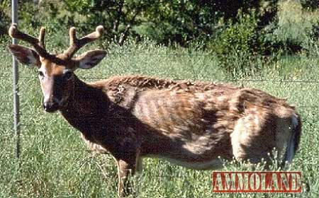
What Causes CWD?
CWD is one of the transmissible spongiform encephalopathy (TSEs) diseases
  Others: Bovine Spongiform Encephalopathy (BSE or Mad Cow disease) and Scrapie affecting sheep and goats
TSEs are not caused by bacteria or viruses, but a prion.
Prion - naturally occurring protein, that when folded incorrectly, becomes both infectious and deadly
Infectious prion proteins continue to convert normal prion proteins in the brain into the abnormal proteins which leads to death of normal brain cells

Slide 6
What Are Signs of CWD?
Most commonly in adult animals, progressive and always fatal.
Physical signs: chronic loss of body condition, coordination, and normal gait/posture.
  Excessive drooling, drinking ,and urination are common in the terminal stages.
Behavioral changes include but not limited to:
  Decreased interactions with other animals, listlessness, decreased fear in human interaction, and repetitive walking in set patterns.
  In elk, behavioral changes may also include hyper-excitability and nervousness.
Clinical signs of CWD alone are not conclusive:
  Confirmation of the disease requires an examination of the brain or lymph nodes performed after death.

Slide 7
Transmission
Primarily through direct contact with the live infected animal.
  An infected animal sheds abnormal prions in bodily fluids such as saliva, urine, and feces
  Doe to offspring spread through placental fluids and/or blood
Spread by indirect contact of equipment contaminated by infected animal secretions containing the prion.
Environmental transmission-
  The carcass of an infected animal is highly contaminated with infectious prions
    Thus proper disposal and decontamination of potentially CWD- infected fomites and tissues is an important factor in reducing the risk of CWD transmission
Prions are highly resistant to heat, ultraviolet radiation and disinfectants.
  Prions can persist in the environment for very long period of time (years to decades)

Slide 8
Are Humans at Risk?
There is no conclusive evidence to show that CWD can be transmitted to humans. Caution is advised.
Hunters are encouraged not to consume meat from animals known to be infected.
Hunters should take common sense precautions when field dressing and processing deer or elk taken in areas where CWD is found.

Slide 9
Potential Impact of CWD
Direct effects on cervid producers
Well being of the animals - CWD affects the lifespan and quality of life for all affected species of cervids
Production and Profit - herd health and genetics management can be far more challenging in a positive CWD herd.
Movement and marketability - limiting access to buy and sell cervids, or even breeding leases

Slide 10
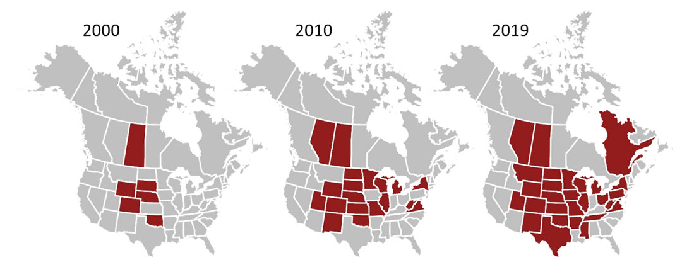
Progression of CWD Detections in the United States

Slide 11
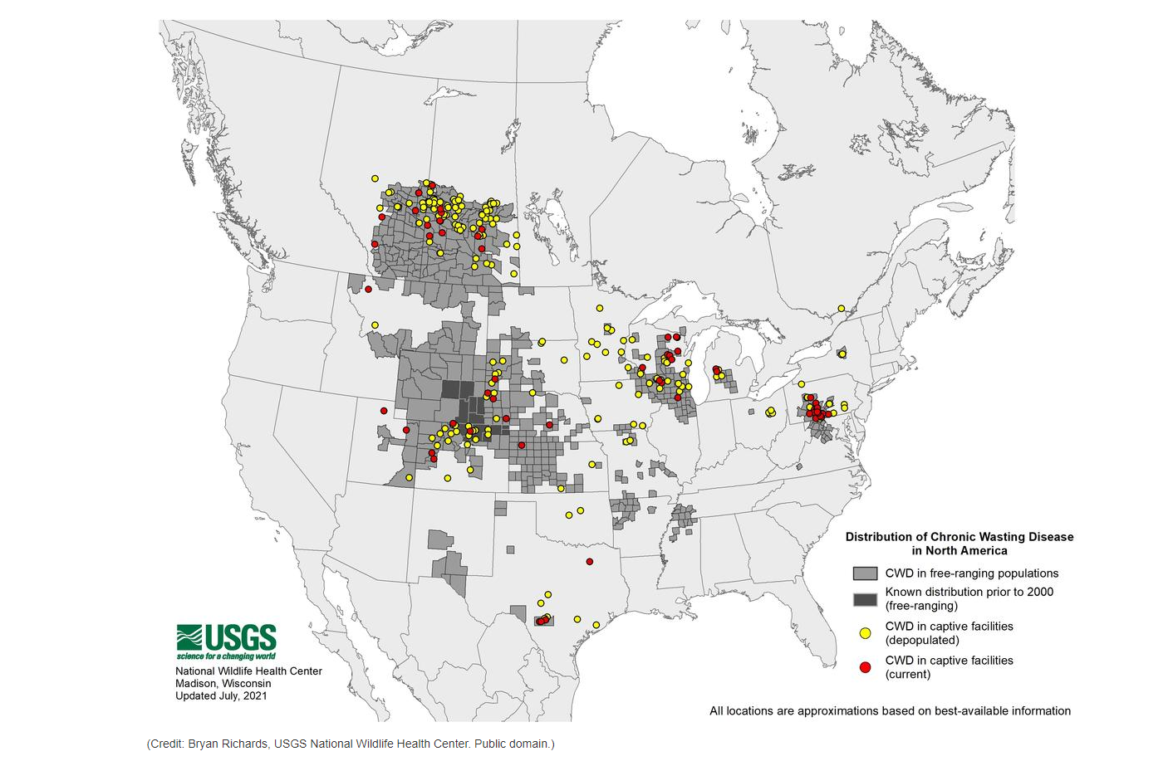
Distribution of CWD in North America (As of July 2021)
Since 2001- 21 states Identified CWD in wild cervids
Since 1997- 16 states detected CWD in farmed cervids

Slide 12
CWD National Control Efforts
1997-98: Nationwide Surveillance effort
2002: At the request of Congress, US Department of Agriculture (USDA) worked with states to create a national CWD control plan.
  National CWD Herd Certification Program Developed
  28 states currently participating in the program
  Approved participating states must meet the USDA CWD Herd Certification Program Standards
Kentucky ‘s Cervid Chronic Wasting Disease Surveillance and Identification (CCWDSI) Program meets the requirements of USDA program standards.

Slide 13
Regulatory Oversight of Farmed Cervids in Kentucky
In Kentucky Farmed Cervids are regulated by
  Kentucky Department of Agriculture’s Office of State Veterinarian (OSV)
  Kentucky Department of Fish and Wildlife Resources (KDFWR)
This presentation focuses on the OSV regulatory program and requirements for cervids
For information regarding the KDFWR program contact their office or visit https://fw.ky.gov/Wildlife/Pages/Transportation-and-Holding-of-Captive-Cervids.aspx

Slide 14
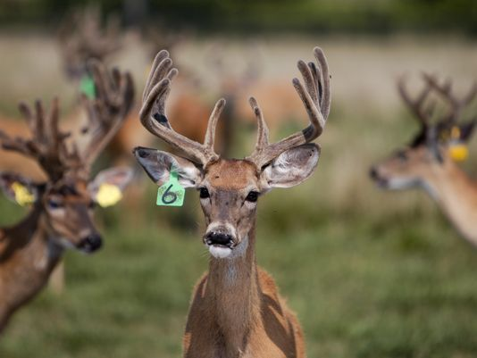
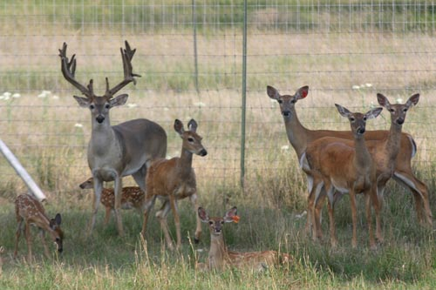
CCWDSI Program Basics
The Farmed Cervid Program Managed by the Kentucky Department of Agriculture’s Office of the State Veterinarian
Note: For additional farmed cervid regulations contact Kentucky Department of Fish and Wildlife Resources

Slide 15
Who is required to be enrolled in the CCWDSI Program in Kentucky?
    Any Premises with Farmed Cervid
    Definition of Farmed Cervid:
      A farmed cervid means cervid livestock that are enrolled in a Cervid Chronic Wasting Disease Surveillance and Identification (CCWDSI) program and are maintained for propagation, selling, trade, or barter or for taking by any harvest or slaughter method.
  Farmed cervids shall exclude any cervid that has not originated from and been continuously maintained within a herd that is enrolled in and complies with a CWD certified or monitored program.
  Absolutely all wild cervids are prohibited within farmed cervid facilities.

Slide 16
How to enter the Farmed Cervid Program?
Interested New Producers: Before first animals are moved onto the property
Review requirements of KY Department of Fish and Wildlife Resources and the Kentucky Department of Agriculture
  https://fw.ky.gov/Wildlife/Pages/Transportation-and-Holding-of-Captive-Cervids.aspx
  https://www.kyagr.com/statevet/farmed-cervids.html
Complete KY Department of Fish and Wildlife Resources required Facility Inspection
  Regulations for Facility Inspection are located in 301 KAR 2:083
Complete the KY Department of Fish and Wildlife Resources' Approved Captive Cervid Permit Application
  https://fw.ky.gov/Wildlife/Documents/cervidapp.pdf
Complete the Kentucky Department of Agriculture’s Approved CCWDSI Application and required Program Training

Slide 17
2021 Annual Renewal Requirements
For Annual Renewals 2021:
KDA Requirements
Renewal applications and associated fees are due December 31st each year you are participating in the program.
Review program training presentation provided by KDA
Submit program training quiz with application renewal.
FWD Requirements:
Annual facility inspection ranging from Jan. 1- Feb. 28th of the current year and associated inspection fee.

Slide 18
Requirements for Cervids Entering a KY Farmed Cervid Herd
All animals entering your premises must:
  Have a RFID 840 identification
  Be accompanied by a Certificate of Veterinary Inspection (CVI) and Movement Permit
  Originate from other herds enrolled in the Kentucky HCP, or from a herd in a state, approved by the OSV, with an USDA-approved CWD Certification Program in which CWD has never been confirmed.
Importation of cervids from any state which originates from or has resided in a state where CWD has been confirmed in either wild or captive cervids is PROHIBITED.
  Contact the KDA Representative to determine which states are approved for cervid import into KY.
  Importation of live cervids from an approved state requires a movement permit (USDA Form 1-27) which must accompany any cervid being transported.

Slide 19
Two Herd Certification Programs Available: Herd Certification Program (HCP) and
Herd Monitored Program (HMP)
HCP:
“Certified“- status achieved by a herd meeting standards of CWD HCP continuously for at least five (5) years.
For breeding purposes
HMP:
“Monitored” - farmed cervids in harvesting facilities (terminal) for CWD.
Intentional breeding is PROHIBITED
*All farmed cervid herds shall be enrolled in one (1) of the state programs*

Slide 20
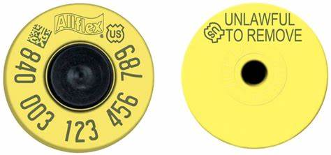
Animal Identification Requirements
All animals on the premises at the time of annual inspection (prior to April 30th each calendar year) must be identified with two (2) forms of identification,
  one (1) visual (flop tag) type of animal identification.
  one of which MUST be an Official 840 Radio Frequency Identification Device (RFID) and
    Official RFID tags can be recognized by the official U.S. shield present, EID capabilities, and an “840” sequence.
All animals of any age shall have official animal identification before being moved from the premises for any purpose.
Permit holders failing to meet identification requirements shall be subject to compliance plans and penalties as provided in KAR 22:150 Section 3. (b) 1. and Section 8. (7)

Slide 21
Animal Inventory - Record Requirements
(Must maintain a current inventory at all times)
It is the responsibility of the producer to maintain and provide upon request the following herd records:
Complete inventory of animals including the official RFID identification number and any other identification, and the age and sex of each animal;
A record for each purchased or natural addition to the herd including:
  The name and address of the person and herd from which the cervid was purchased;
  A copy of the Certificate of Veterinary Inspection that accompanied the animal for intra- or interstate movement; for import and export
  Approximate date of birth if a natural addition
Death or harvest; date of death, the apparent cause of death
All records should be maintained for at least 10 years

Slide 22
Intrastate Movement – Inside Kentucky
Requirements for moving cervids within Kentucky:
Accompanied by a Certificate of Veterinary Inspection (CVI)
A movement permit number assigned by the OSV
An OSV representative, USDA representative, or an USDA category II accredited veterinarian shall be present at the loading point of origin, or the unloading of the cervids at the point of destination for movements to a different premises.
  Scheduling of OSV representatives for loading/offloading must be between the hours of 6am and 9pm.
The requirements of this section shall be the responsibility of the owners, agents, and haulers of the moved cervid.

Slide 23
Interstate Movement – Entry into Kentucky
Requirements
Only cervids from "Certified CWD Herds" in a state which has not detected CWD shall enter Kentucky (i.e. Indiana).
An entry permit assigned by the OSV prior to entry of cervids into Kentucky.
The interstate certificate of veterinary inspection shall include the following:
  Consignor/Consignee name, address, and state veterinarian issued farmed cervid permit number; and
  And RFID Official individual animal identification for each animal
All animals entering shall have a negative official Tuberculosis test within 90days of entry or be originating from a tuberculosis accredited free herd.
All cervids entering shall be accompanied by a valid CVI and USDA Form 1-27
An OSV representative, USDA representative, or an USDA category II accredited veterinarian shall be present at the loading point of origin, or the unloading of the cervids at the point of destination for movements to a different premises.
  Scheduling of OSV representatives for loading/offloading must be between the hours of 6am and 9pm.

Slide 24
Interstate Movement (Exiting KY)
Currently the only state KY exports cervids to is Indiana
Indiana requirements:
  CWD Certified, Brucellosis Certified, and Tuberculosis Certified.
  CVI
  Entry Permit (Obtained from Indiana BOAH)
Export to other states requires pre-authorized by the State Veterinarian.
  Contact OSV representatives for additional information.

Slide 25
Fawn Reporting Requirements
Total number of fawns must be recorded on the permit renewal or application form.
Must be individually identified with an 840 RFID and a visual (flop) tag at the time of first handling event.
Must be reported individually on inventory by the time of annual physical inspection Jan. 1- April 30th.
Fawn deaths must be reported within 7 days of the death. (Fawns do not need to be tested).
Fawns are required to be in compliance with all regulations prior to issuance of a movement permit.

Slide 26
Reporting Requirements
The owner shall report to the OSV all animals that escape or disappear, and all deaths (including untagged fawns, and animals killed by harvest or slaughter) of animals in the herd.
Reports are made in writing to statevet@ky.gov.
Escapes
    For animals that escape or disappear, a report shall be made within forty-eight (48) hours to OSV;
    Within 7 days of initial escape, an updated inventory must be provided to the OSV in writing.
    OSV representative must may require physical inspection to confirm inventory
Deaths
    For animals that die for any reason a report shall be submitted within seven (7) days to OSV
    This includes fawns that are not yet officially identified, for the purpose of disease monitoring

Slide 27
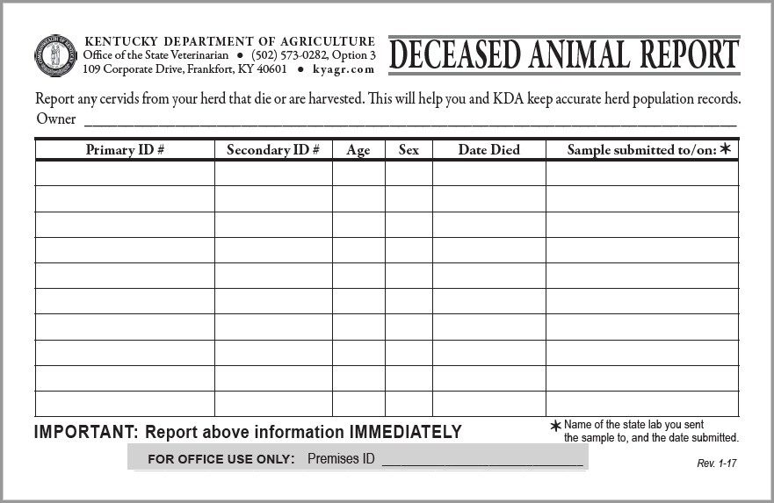
Reporting Missing or Dead Animals
For your convenience, our office provides you with “Deceased Animal” cards. This card tells you specifically what information you need to report.
If you do not have any “Deceased Animal” cards, you may email, fax, or mail the information to our office.
Phone calls ARE NOT an acceptable method of notification.

Slide 28
Disposal of Carcasses
Owners shall dispose of carcasses within forty-eight (48) hours after the carcass is found unless the carcass is otherwise preserved in cold storage
  Complete incineration
  Boiling/Rendering
  Burying
  Composting
Failure to properly dispose of a carcass shall be subject to penalty
KRS 257.160

Slide 29
Testing Requirements
Animals that die shall have the required tissue specimens collected for CWD testing.
Surveillance procedures for HCP’s and HMP’s
  HCP and HMP Certified Herds: Cervids twelve (12) months and older that die for any reason must submit tissues (obex AND retropharyngeal lymph nodes) for sampling and testing in accordance with USDA testing standards.
  HCP must submit sample to approved lab within 7 days of death
  HMP must submit sample to approved lab within 30 days of death
Federal and/or State authorities shall investigate herds that fail to comply with testing requirements and shall evaluate the herd’s status.
Failure to meet testing requirements may result in suspension of herd certification status.

Slide 30
Lab Testing Requirements
Samples are to be collected by approved certified sample collector or a veterinarian.
Only approved labs are to conduct official CWD testing
  Breathitt Veterinary Center (BVC)
  University of Kentucky Lab (UKL)
  National Veterinary Services Laboratory (NVSL)
A diagnosis of CWD by an approved laboratory will be confirmed by the NVSL.
If required tissues from test eligible cervids are not submitted for laboratory diagnosis, the state veterinarian shall re-evaluate the status of the herd.
Copies of all test results are to be kept in your records (up to 10 years) to make available to OSV representatives.

Slide 31
Approved Sample Collector Certification Course
As of July 9, 2021 CWD samples must be collected from:
  OSV Certified CWD Sample Collector
  USDA Accredited veterinarian
  Officials at approved laboratories
OSV will continue to conduct annual or biannual certification courses as needed to allow producers to collect their own samples.
Certification will last 5 years from the date certified, or until new sample collection protocols have been mandated
To confirm sample collector certification or to request enrollment in next certification course contact the OSV Cervid Program Coordinator

Slide 32
HCP Required Inspections
  Annual
  Physical Inventory (Physical or chemical restraint required)
  Period: January 1st – April 30th
  The owner shall be responsible for assembling, handling, and restraining the animals and for all risks and costs incurred, to present the animals for inspection.
  Records Review
Quarterly
Periods include:
  April 1st –June 30th
  July 31st- September 30th
  October 1st - December 31st
  Visual identification of cervids and record review
  State Veterinarian or APHIS representative may request a visual or physical inventory to verify compliance

Slide 33
Thank you!
Your participation and collaboration to prevent the entry and spread of CWD into Kentucky farmed cervid herds is greatly appreciated.
Please use this presentation and the regulations set forth by 302 KAR 22:150 to accurately complete the quiz attached to your 2021 CWD Program permit application

Slide 34
For More Information
Program Contact:
  Jamie Gravitt, Cervid Program Coordinator
  Phone 502-782-5922
  Email: Jamie.Gravitt@ky.gov
Website:
  https://www.kyagr.com/statevet/farmed-cervids.html

