Slide 1
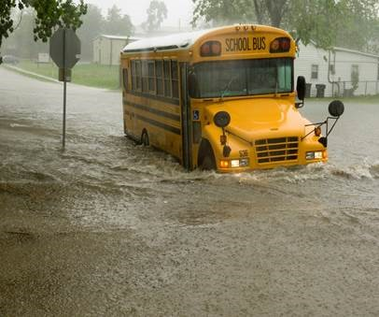
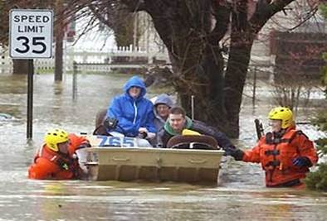
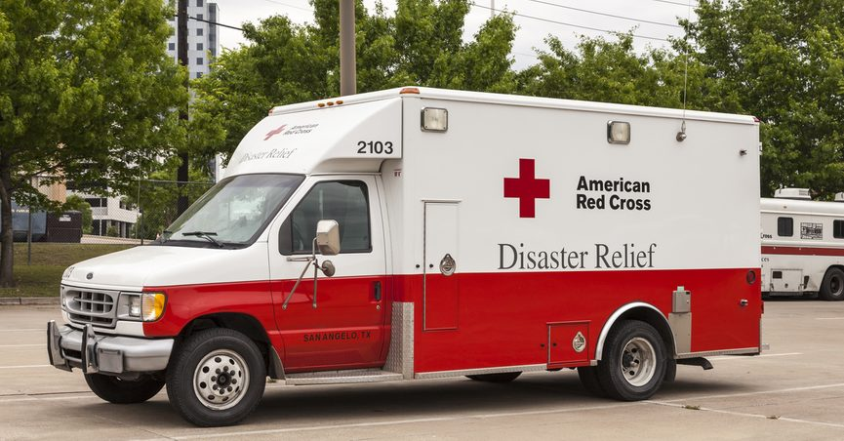
Food assistance during Disasters/emergencies
Jessica Garland- Kentucky School Districts

Slide 2
Presentation will address
Types of disasters
Approved disaster relief organizations
Identifying USDA donated foods that can used
Record keeping/submitting
USDA donated food replacement
District disaster preparedness plan

Slide 3
Disaster team Map
Notes:
Disaster Team

Slide 4
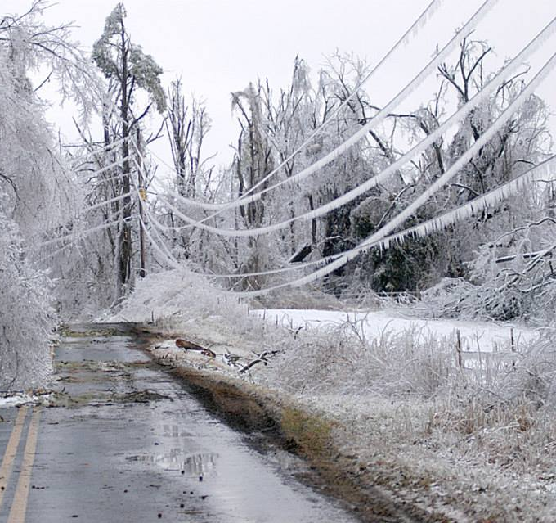
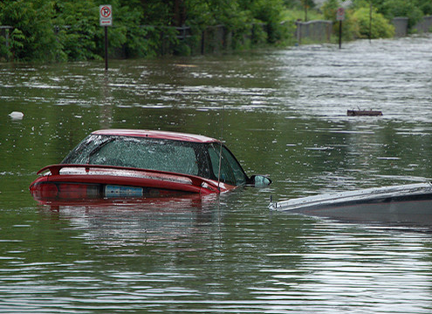
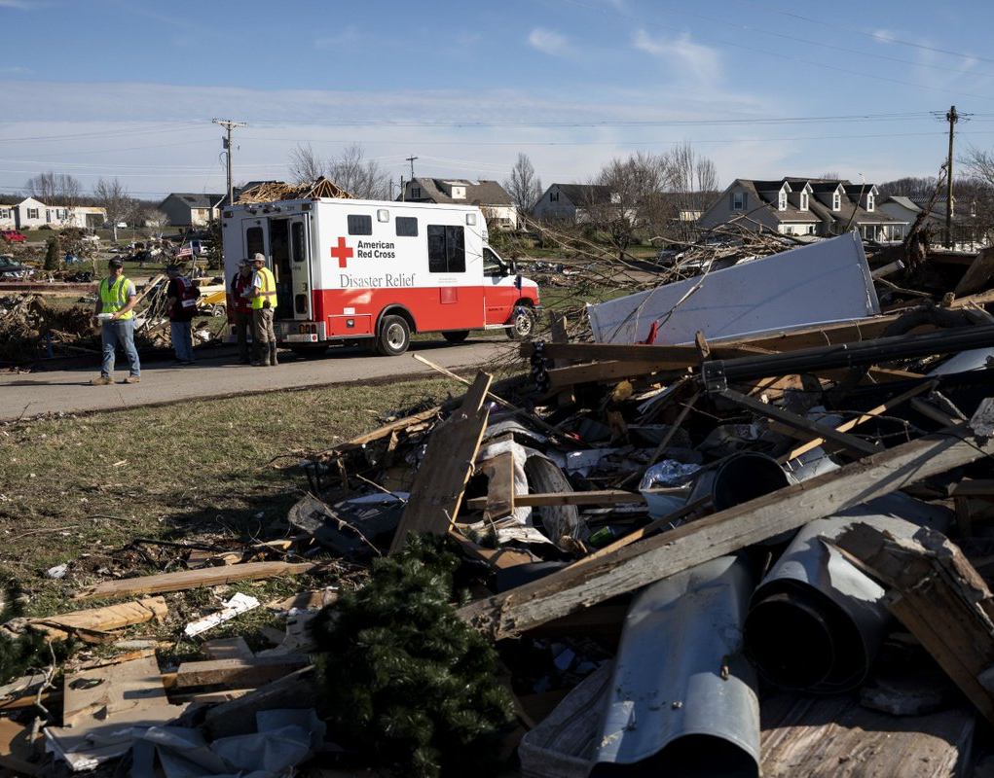
What is a disaster/situation of distress?
“Disaster” can be any natural catastrophe, or regardless of any cause fire, flood, explosion, in any part of the US, which the president determines causes damage of sufficient magnitude to warrant federal assistance.
“Situation of distress” means a natural catastrophe in which the state distributing agency of food nutrition services (FNS) warrants the use of USDA-donated foods.
Notes:
The 2009 Ice storm-Harrison County

Slide 5
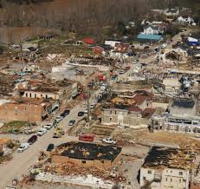
Difference between disaster and situation of distress
Notes:
Picture is Morgan County- March 2012

Slide 6
Plan and Prepare
Develop a disaster and communication plan
Early and frequent communication is critically important
Establish a disaster response team

Slide 7
Plan and prepare
Update
Update the plan annually
Establish
Establish recordkeeping procedures
Identify and develop
Identify and develop relationships with DA contacts and local disaster organizations

Slide 8
Ra Preparation
Become familiar with the approval process for using USDA Foods in disasters
Establish/maintain/update emergency contact information for all key players
Coordinate and communicate all necessary information with partners at your State and local government level and with non-governmental organizations
RAs should provide training for applicable staff on the disaster plan and the role of USDA Foods annually
Compile USDA Foods inventory information

Slide 9
RA Preparation
Maintain emergency contact lists to include work numbers, cell numbers, and e-mail addresses of designated disaster personnel and central office administration
Provide emergency RA contact information to essential DA personnel
Assess current inventories of USDA Foods that may be needed to supplement non-governmental organizations and state emergency response agencies and report USDA Foods inventories to DA if requested
Provide location, dates, and times for disaster feeding to the DA

Slide 10
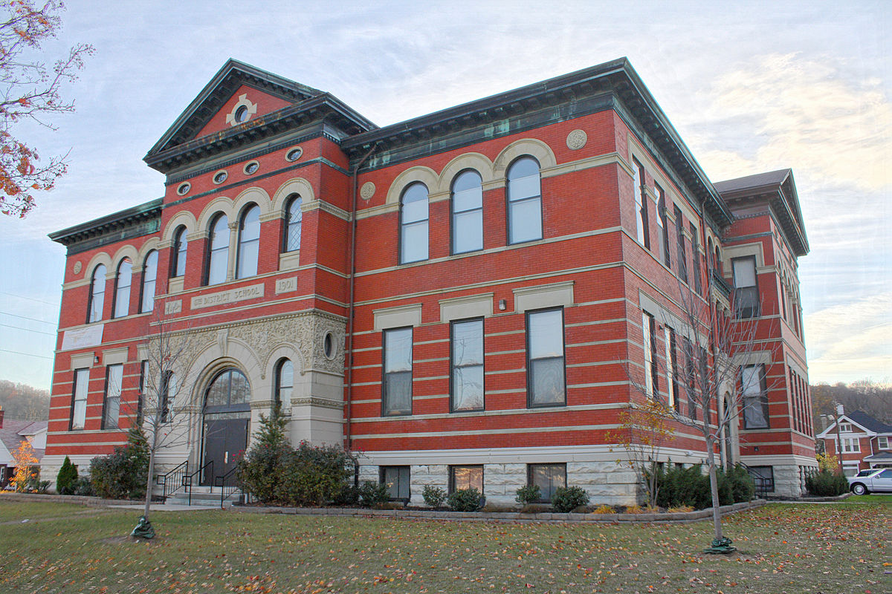
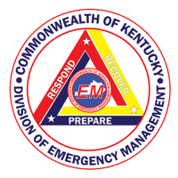
Emergency contact list

Slide 11
RA Response during a disaster
Provide
Provide daily updates on sheltering populations, if applicable
Report
Report USDA Foods used for disaster feeding (congregate and DHD) to DA
Participate in
If requested, participate in calls with DA to provide local updates
Develop and maintain
Before a disaster, develop and maintain relationships with your State and community partners so you know who to contact when a disaster event occurs
Conduct
After a disaster, conduct an after-action to critique and evaluate actions taken during the disaster

Slide 13
USDA food requests for disaster relief organizations
The Kentucky Department of Agriculture (KDA) may release USDA Foods maintained in schools to approved disaster relief agencies such as red cross, salvation army and religious based organizations. In most instances the red cross is the primary organization responsible for coordinating disaster feeding.
The Food Nutrition Service (FNS) will only reimburse USDA foods used for feeding efforts through KDA approved disaster agencies during disasters or a situation of distress- districts that choose to donate foods to unauthorized agencies/groups will not be reimbursed through FNS
Disaster relief organizations prefer institutional pack size over household foods for emergency feeding, such as those used in the national school lunch program as they are easier to handle and guarantee replacement under presidentially declared disasters.
Although processed foods are USDA foods and can be released to disaster relief organizations. USDA will “only” reimburse the value of the raw USDA product contained in the further processed item.

Slide 14
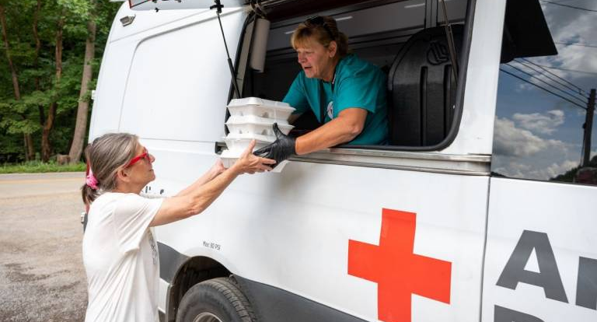
Southern Baptist-red cross

Slide 15
Kda emergency inventory report FD-52
During an impending disaster/emergency, you may be emailed the KDA Emergency Inventory report (KY-FD-52) and asked by your KDA food distribution Regulatory Specialist to complete the form for your district.
Complete the KY-FD-52 for each school within your district. List the types of USDA“Brown Box” foods only, sales order number and quantities of these foods you have on hand for each school.
Compile totals for all schools on one “electronic” KY-FD-52 form and email it your Regulatory Specialist. Do not scan, fax or copy this form.
KDA needs KY-FD-52-inventory report within 6 hours upon request.

Slide 16
Fd-52

Slide 18
Usda food emergency feeding report fd-50
Once donated foods are requested by the KDA to be released to disaster relief organizations, it is essential that local agencies keep track of these products using the USDA food emergency feeding report KY-FD-50 once this form is completed send it in electronically to your Regulatory Specialist asap!
KDA has 45 days from termination of the emergency assistance to request commodity replacement in a declared disaster or 30 days during a situation of distress.
Make certain that all fields on the KY-FD-50 contain all relative information insuring each section is completed on the form properly before submitting to your KDA Regulatory specialist.
Notes:
We will explain in further detail on the next slides

Slide 19
Fd-50

Slide 20
* For further information in regards to usda product information including sales order numbers, unit price and unit size. log into web based supply chain management (wbscm)

Slide 22
What do I do if the red cross requests usda foods?
The red cross will notify KDA to request which USDA foods they will need from your district for disaster feeding.
“If” the red cross needs your district’s foods, your regional Ag Regulatory Specialist will let you know which foods/quantities you listed on your KY-FD-52 that will need to be pulled from each school site.
Prepare these foods for pickup
School sites can also release USDA purchased foods of the same type/quantity.
The red cross member/volunteer will be required to show identification to you/your staff prior to releasing these USDA foods

Slide 23
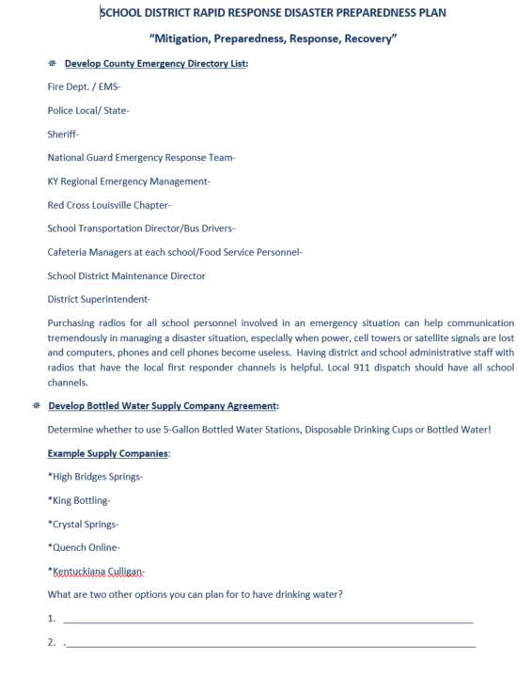
How can my school district prepare for a disaster?
Develop a plan- it is very important that every district puts in place a disaster preparedness plan. This will assist you in the event of a disaster/emergency
Methods if identification
Red marker/color stickers
Separation of USDA foods and purchased foods
*Locate template in the back of your disaster manual*
Notes:
This is page 1 of 3 as an example of what you have located in the back of your disaster manual

Slide 24
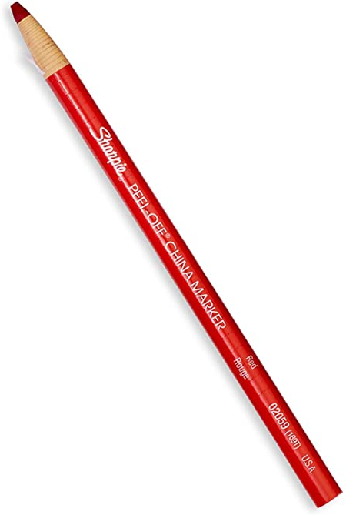
Notes:
Montgomery county schools storage area!

Slide 25
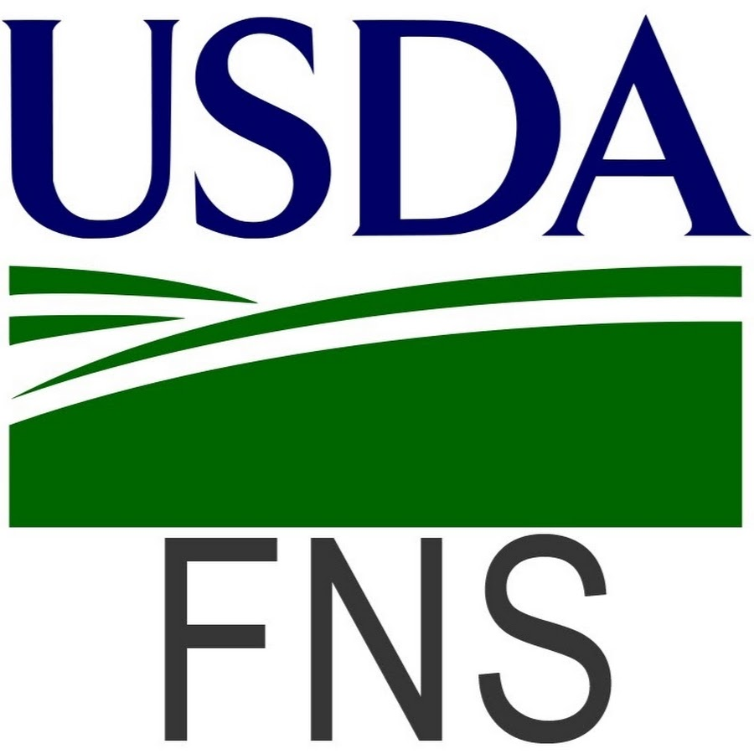
When will my district be reimbursed for our usda foods?
Your districts report will be submitted to the food and nutrition service (FNS) southeast regional office for reimbursement once the disaster feeding is completed
Under a Presidentially declared disaster, FNS guarantees replacement/reimbursement of USDA foods used in the disaster feeding. There is no set time within the USDA foods program as to when districts will be reimbursed.

Slide 26
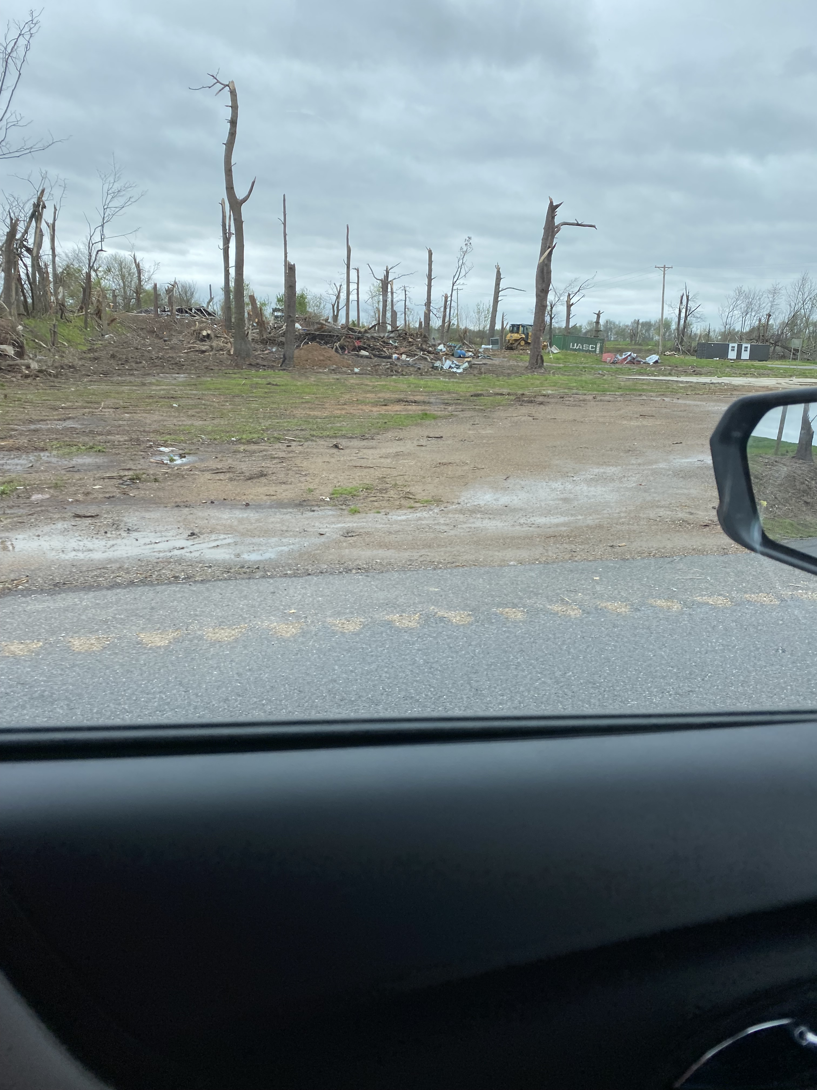
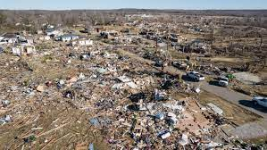
Dec 10th, 2021- Tornado response

Slide 27
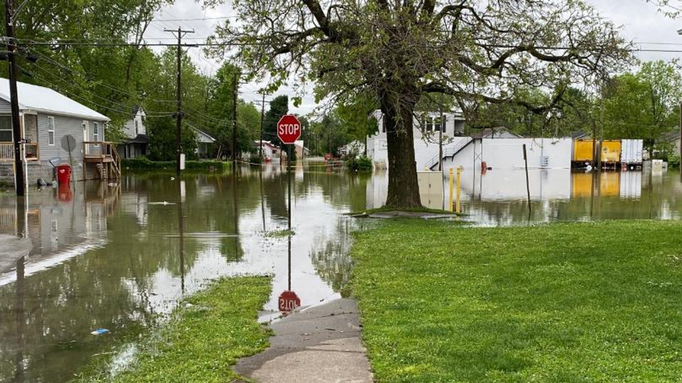
Harrison County Flood - 2019
2009 Icestorm- Grand Rivers Ky
Johnson County-2012 Tornado

Slide 28
Eastern KY Flooding- July 26-28th

Slide 30
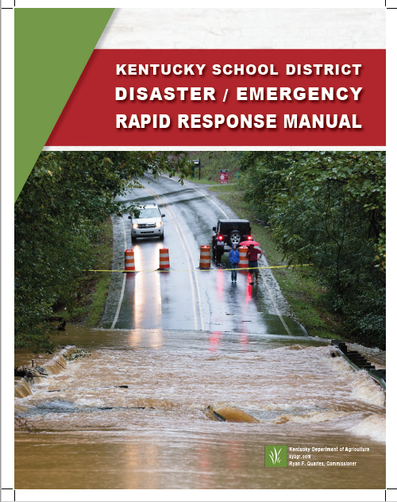
questions?
All forms can be found at www.Kyagr.Com
Any further instructions regarding forms, documents and other disaster related information can be found in your emergency disaster manual!

