Slide 1
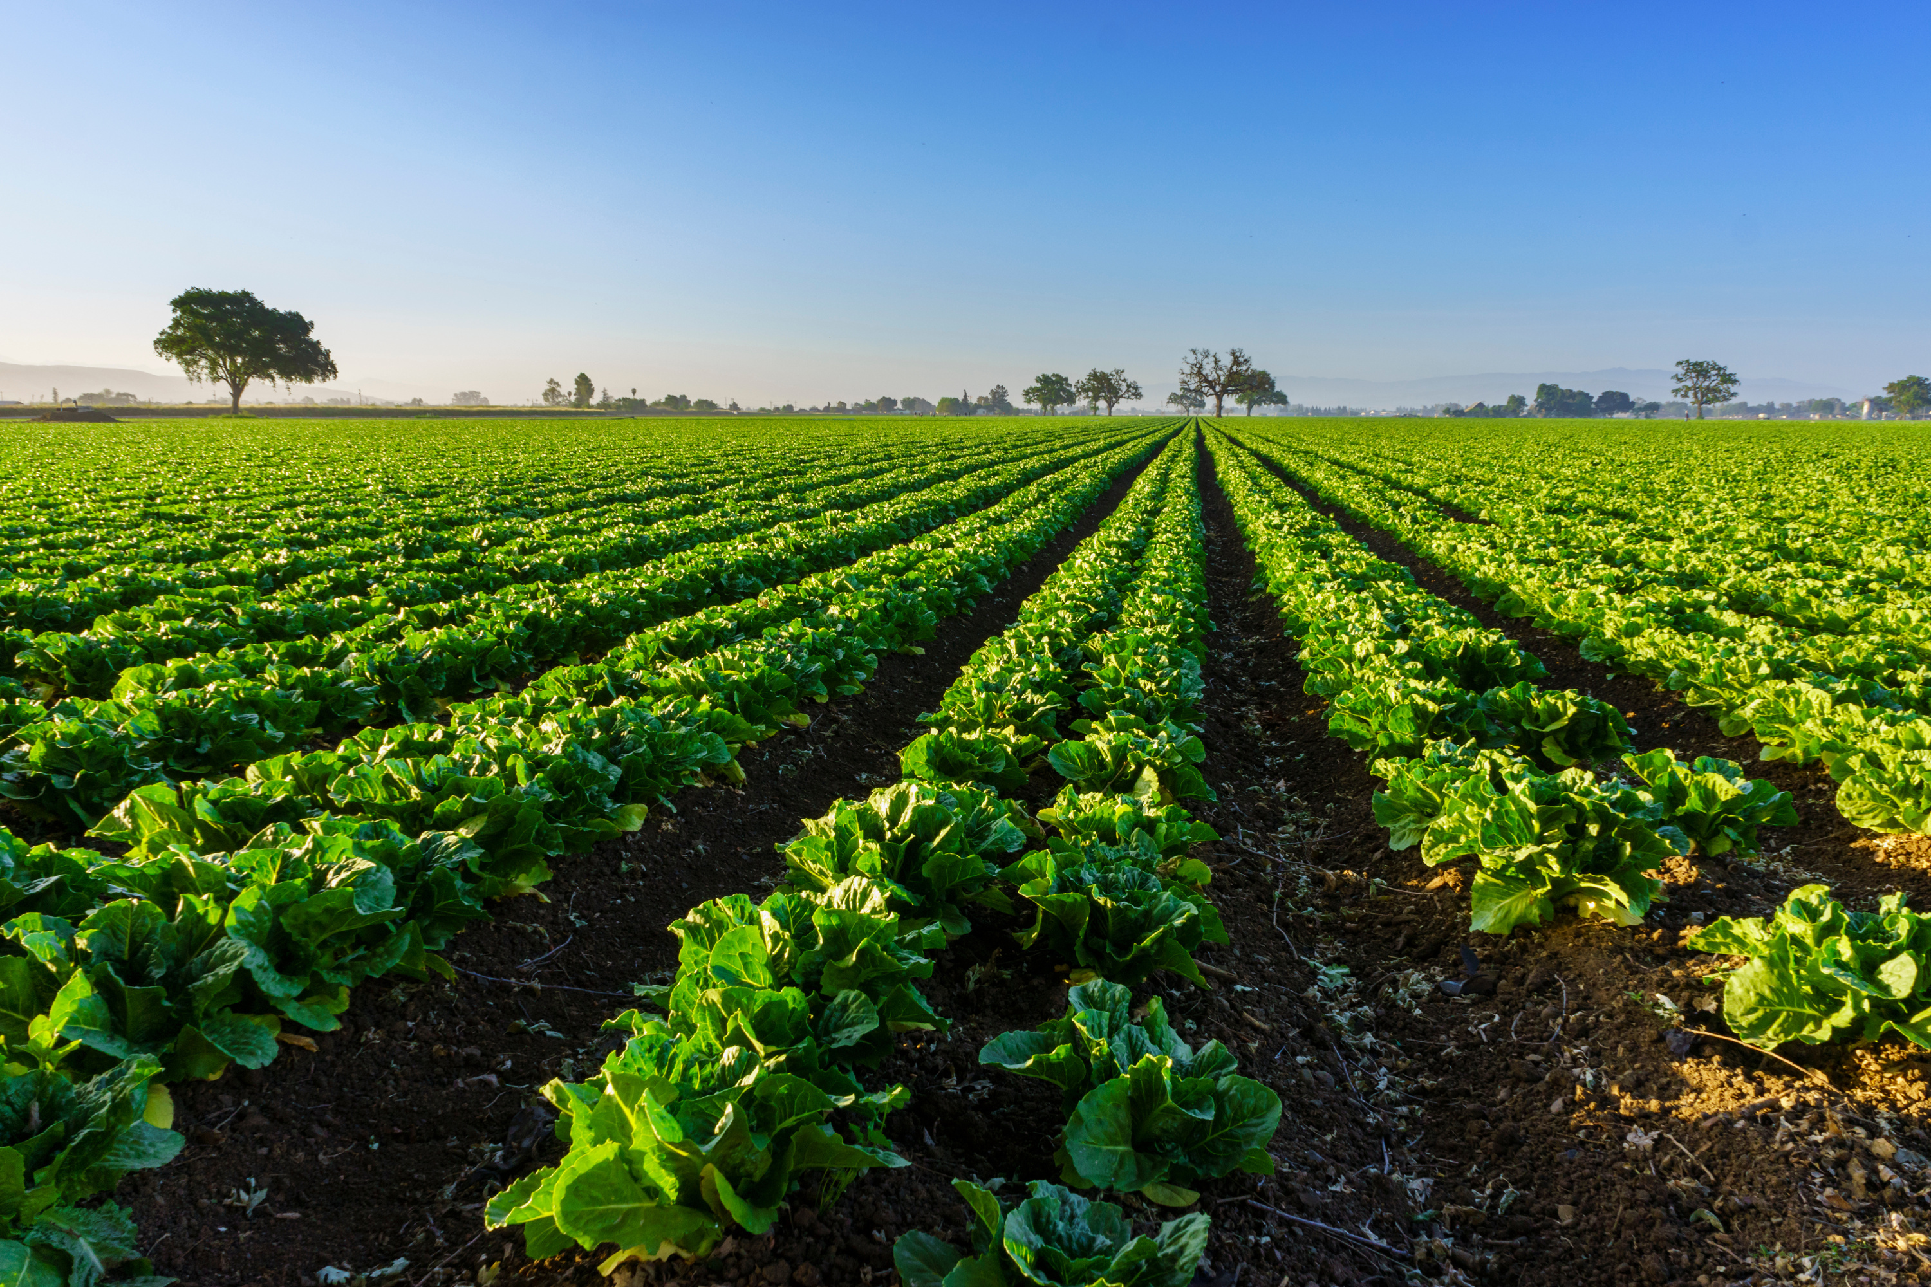
https://www.kyagr.com/consumer/senior-farmer-market.html
FOODS DIVISION
SENIOR FARMERS MARKET NUTRITION PROGRAM
Kentucky Department of Agriculture
Presented by:
Jesse Frye
Tina Garland

Slide 2
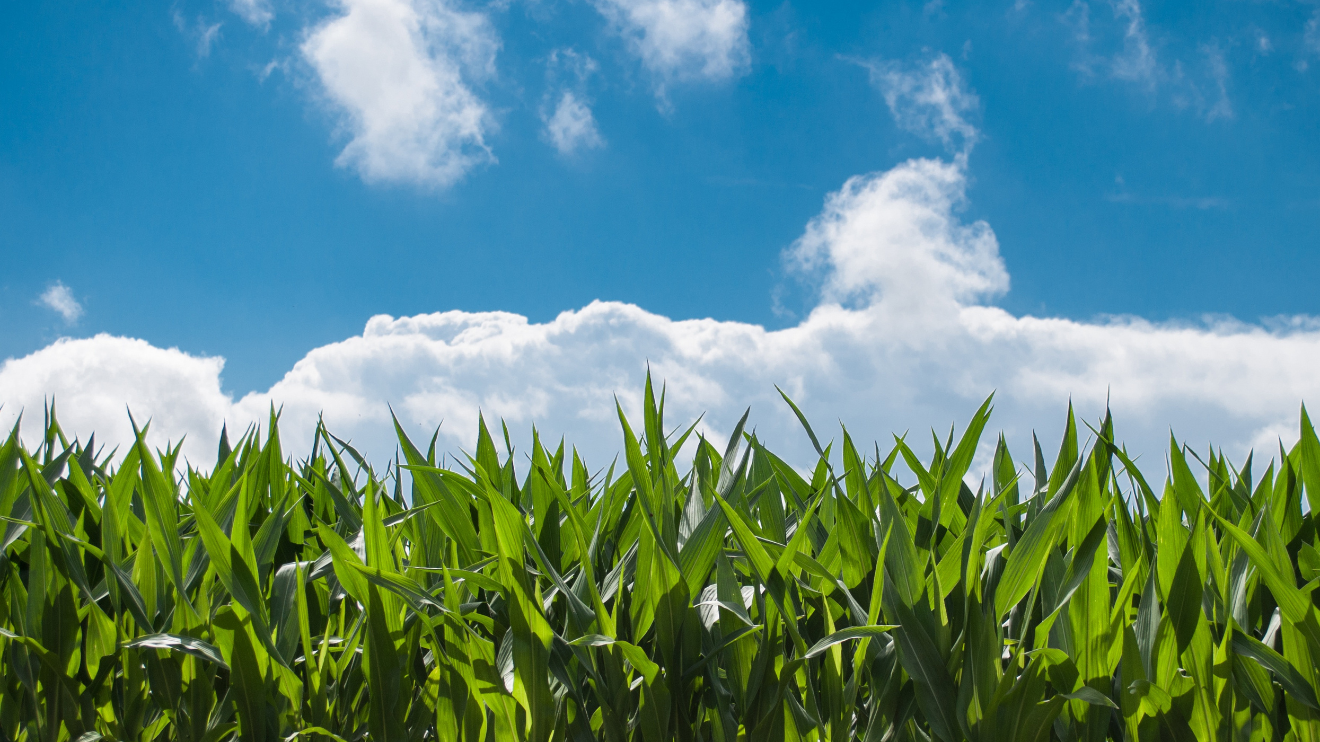
STATISTICS
2024 year end redemption rate was 90%
12,545 issued cards in 2024
45,202 Market Transactions
Total Sales $489,485
Average sale for Participating Farmer was $925

Slide 3
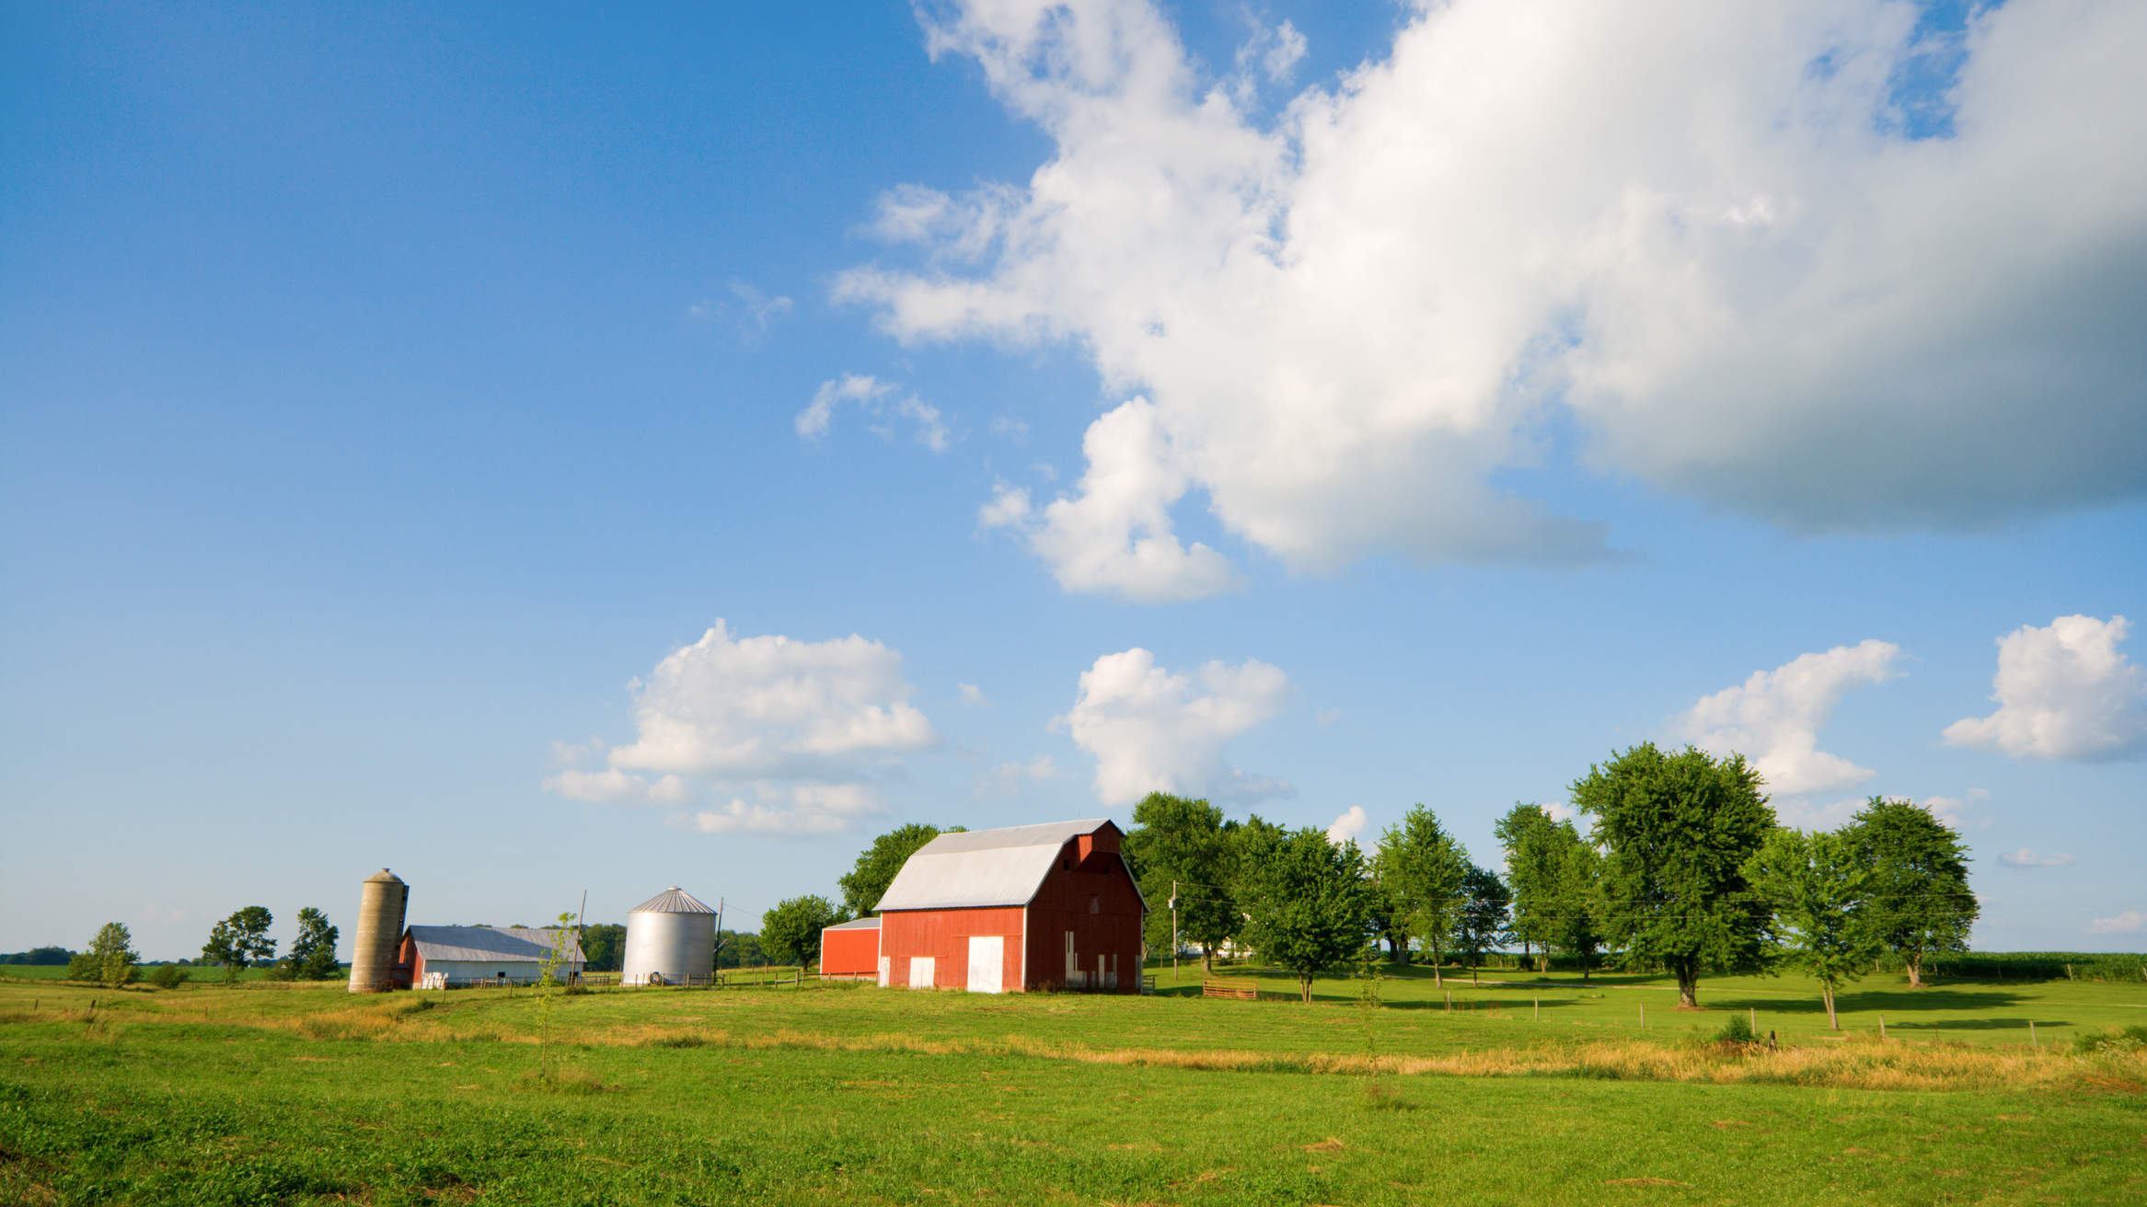
2024 A HUGE SUCCESS
We, KDA, would like to thank the 116 Farmers’ Markets and 98 Distribution Agencies who did not waiver in the face of change to make all this happen for the seniors of Kentucky. Approximately 12,545 seniors received benefits.

Slide 4
Qualifications for Farmers’ Markets
The market must be an organized market. To be considered “organized,” the market must have an established contact person/decision maker and meet at a named location at least once a week during the market season with specified days and operating times.
The market must experience one full growing season as a registered KDA market before submitting a new market application to the SFMNP.
The market must be registered with KDA and approved as a Kentucky Proud market.
The market must sell locally grown fresh produce. Locally grown means grown in Kentucky or within 50 miles of the Kentucky border.

Slide 5
Farmers’ Market Managers’/Coordinators’ Responsibilities
Operate Farmers’ Markets in accordance with USDA guideline, 7 CFR Part 249.
Guarantee participating farmers are in compliance with SFMNP Farmer Participation Guidelines.
Receive training and training materials annually on SFMNP procedures.
Agree to be monitored for compliance with SFMNP requirements.

Slide 6
Farmers’ Market Managers’/Coordinators’ Responsibilities
Provide KDA SFMNP Coordinator or Branch Manager documentation, within 7 days, if there is a change of market coordinator and any change of address information.
Provide KDA SFMNP Coordinator or Branch Manager a schedule of the hours, days and duration of the market operation and any market schedule changes.
Retain all agreements and records pertaining to the SFMNP for 3 years plus the current year. If any claims, actions or audit findings have not been resolved, records shall be retained until the actions or findings have been resolved.

Slide 7
Farmers’ Market Managers’/Coordinators’
Responsibilities To Farmers/Vendors
Provide training to authorized farmers and any employees with SFMNP responsibilities and procedures.
Collect signed applications of farmers wishing to participate (after training) and submit applications via email to KDA SFMNP Coordinator or Branch Manager by April 1st of program year.

Slide 8
Farmers’ Market Managers’/Coordinators’
Responsibilities To Farmers/Vendors
Agree to conduct annual on-site farm monitoring of all new farmer applicants and at least 10% of farmers which shall include those farmers identified as being highest-risk. High risk farmers are identified by:
any farmer new to the SFMNP
any farmer that has had a complaint lodged against him/her or has shown a disregard for the rules of the program
any farmer having a higher redemption rate than others in the same market

Slide 9
Farmers’ Market Managers’/Coordinators’
Responsibilities To Farmers/Vendors
Public notification of the SFMNP
Display signage provided by KDA SFMNP stating the Farmers’ Market is authorized to redeem SFMNP benefits and stating market hours of operation
Have the capability of providing the above information in a multilingual manner
Display in prominent places, program opportunities and benefits to participants (or potential) and the USDA Title VI nondiscrimination poster

Slide 10
Important Dates for
Market Managers/Coordinators
1
APRIL
1
APRIL
1
MAY
31
OCTOBER
Market contracts due to KDA
Last day farmers can submit applications to KDA
Start of SFMNP market season
End of SFMNP Market Season

Slide 11
Qualifications for Farmers/Vendors
Be a member of an approved KDA and SFMNP Farmers’ Market.
Must attend a KDA approved training session each year and train employees selling at the market on SFMNP procedures.
Post SFMNP sign, provided by KDA with individual identifier (farm) number, at market booth to identify as a vendor.
Offer for sale locally grown fruits, vegetables, honey and cut cooking herbs on the eligible foods list for human consumption. Locally grown means grown in Kentucky or within 50 miles of the Kentucky border.
Provide eligible foods to senior participants at, or less than, the price charged to other customers.

Slide 12
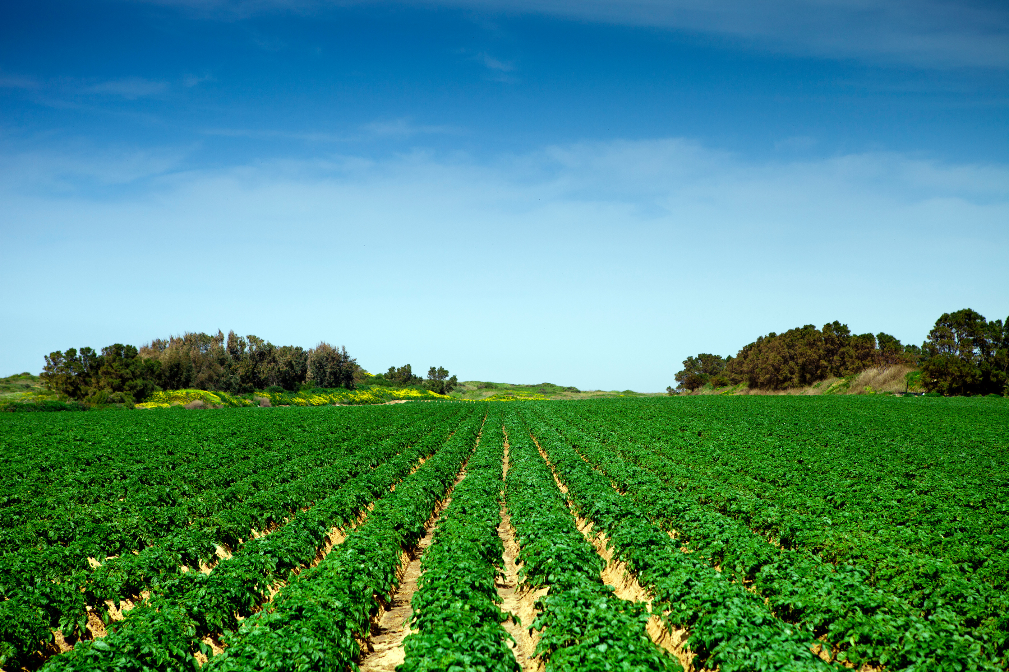
SoliMarket Portal
Mobile app for farmers and cashiers
Available through the apple store or google play
Free to download and use
Activation is through invitation only for farmers and cashiers authorized by SFMNP Coordinator or Branch Manager
Link to activate account is emailed to user with a 72-hour window
Farmer/Vendor needs to enter banking information for deposits
Mobile devices must have a working network connection to perform transactions
Geofencing only allows transactions to be made at designated markets

Slide 13
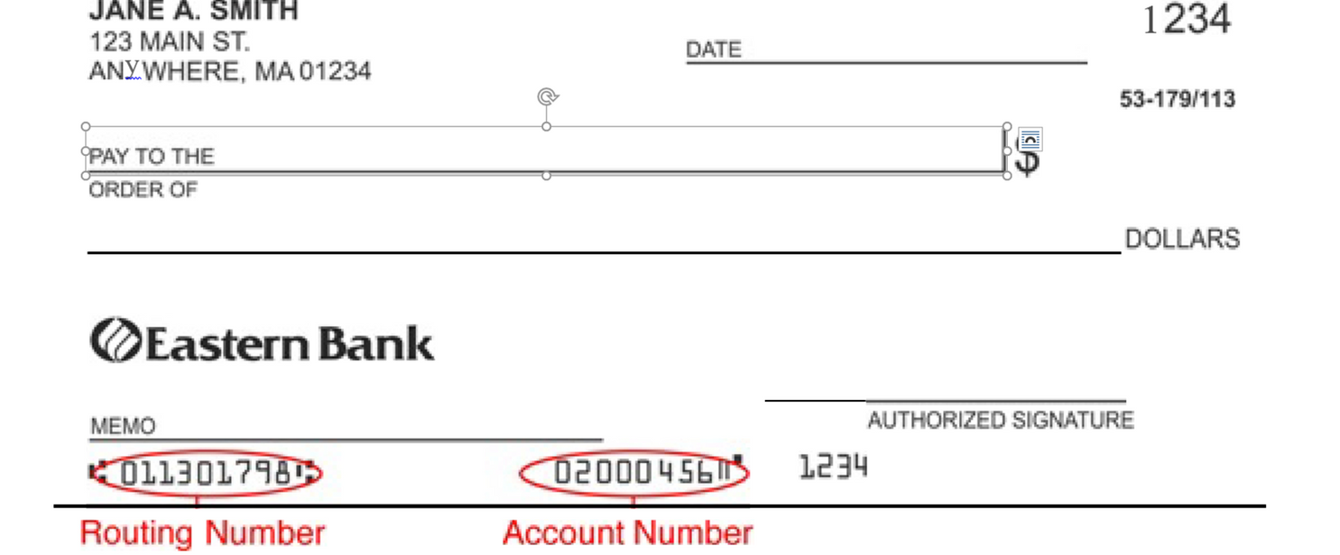
All You Need To Set Up Payment Is Your Routing Number And The Bank Account Number From Your Check

Slide 14
Remittances Are Automatic
Payments to farmers are made weekly by ACH transfer
Farmers do not need to do anything to initiate their payment
Farmers can view sales and pending payment(s) on their app
Transactions are fast and simple

Slide 15
SOLIMARKET RESOURCES
SoliMarket support hotline: 214.256.3083

Slide 16
Civil Rights
In accordance with federal civil rights law and U.S. Department of Agriculture (USDA) civil rights regulations and policies, this institution is prohibited from discriminating on the basis of race, color, national origin, sex, disability, age, or reprisal or retaliation for prior civil rights activity.
Program information may be made available in languages other than English. Persons with disabilities who require alternative means of communication to obtain program information (e.g., Braille, large print, audiotape, American Sign Language), should contact the responsible state or local agency that administers the program or USDA’s TARGET Center at (202) 720-2600 (voice and TTY) or contact USDA through the Federal Relay Service at (800) 877-8339.
To file a program discrimination complaint, a Complainant should complete a Form AD-3027, USDA Program Discrimination Complaint Form which can be obtained online at: https://www.usda.gov/sites/default/files/documents/USDA-OASCR%20P-Complaint-Form-0508-0002-508-11-28-17Fax2Mail.pdf, from any USDA office, by calling (866) 632-9992, or by writing a letter addressed to USDA. The letter must contain the complainant’s name, address, telephone number, and a written description of the alleged discriminatory action in sufficient detail to inform the Assistant Secretary for Civil Rights (ASCR) about the nature and date of an alleged civil rights violation. The completed AD-3027 form or letter must be submitted to USDA by:
1. mail:
U.S. Department of Agriculture
Office of the Assistant Secretary for Civil Rights
1400 Independence Avenue, SW
Washington, D.C. 20250-9410; or
2. fax:
(833) 256-1665 or (202) 690-7442; or
3. email:
program.intake@usda.gov This institution is an equal opportunity provider.

Slide 17
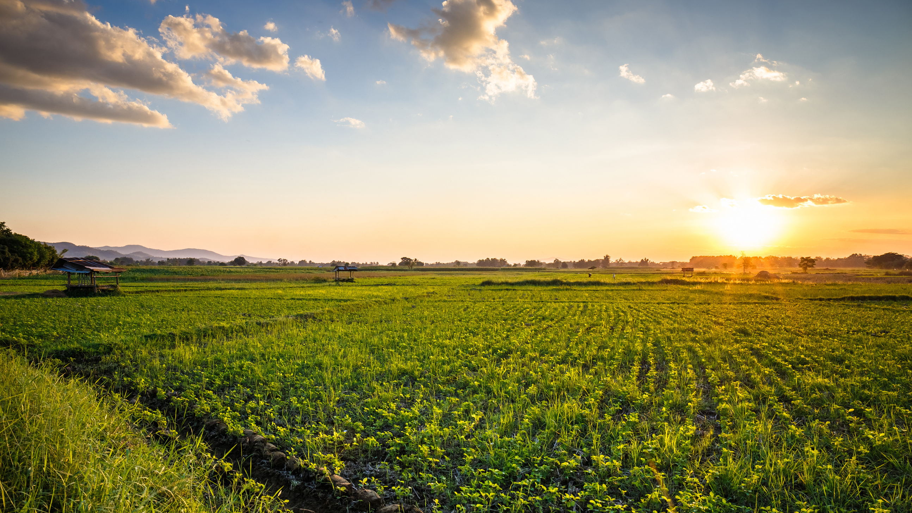
Questions ?
25

Slide 18
www.kyagr.com
Kentucky Department of Agriculture
Division of Food Distribution
107 Corporate Drive
Frankfort, KY 40601
502-573-0282
SFMNP Coordinator:
Jesse Frye, Jesse.Frye@ky.gov Cell: 502.382.7458
Branch Manager
Tina Garland, Tina.Garland@ky.gov Cell: 502.382.7505
Kentucky WIC Program
275 East Main Street, HS2W-D
Frankfort, KY 40601
WIC FMNP Coordinator Alan Peck, Alan.Peck@ky.gov Cell: 502.564.2945

