Slide 1
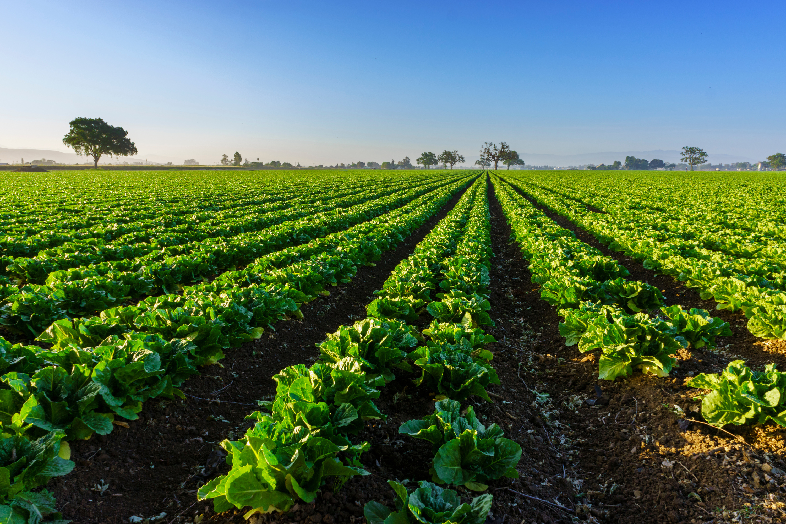
https://www.kyagr.com/consumer/senior-farmer-market.html
FOODS DIVISION
SENIOR FARMERS MARKET NUTRITION PROGRAM
Kentucky Department of Agriculture
Presented by:
Jesse Frye
Tina Garland

Slide 2
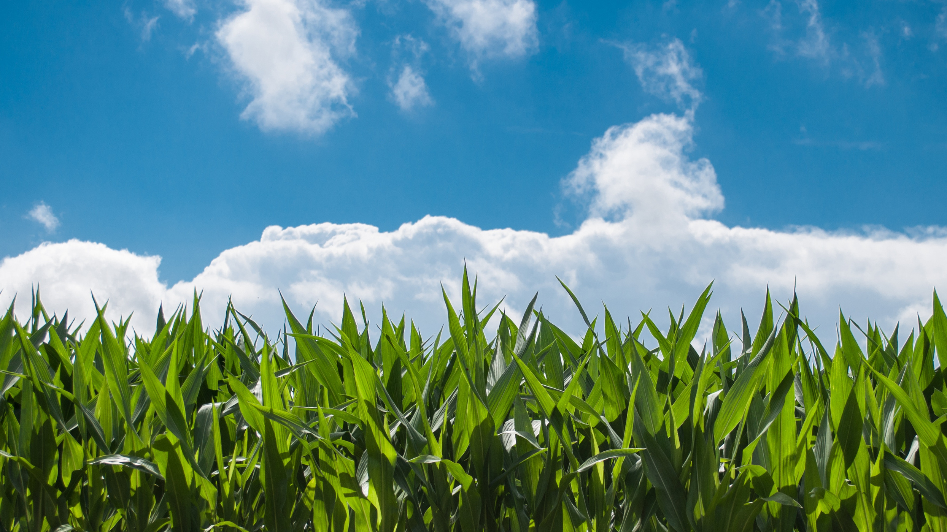
STATISTICS
2024 year end redemption rate was 90%
12,545 issued cards in 2024
45,202 Market Transactions
Total Sales $489,485
Average sale for Participating Farmer was $925

Slide 3
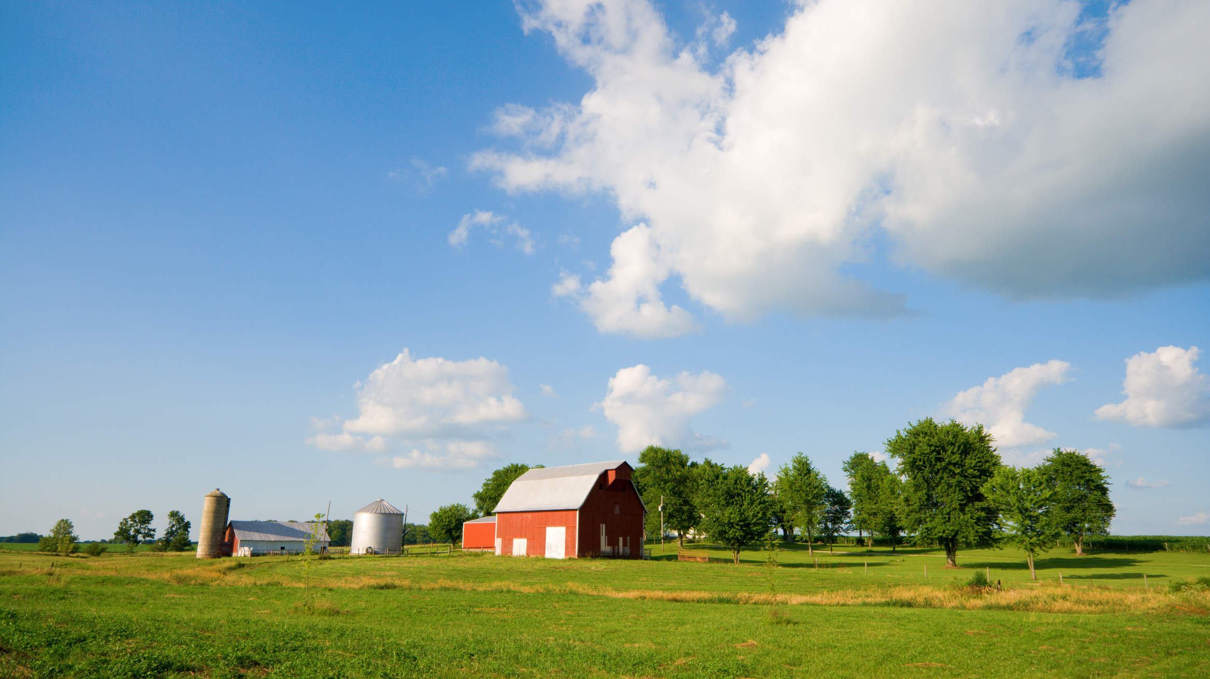
2024 A HUGE SUCCESS
We, KDA, would like to thank the 116 Farmers’ Markets and 98 Distribution Agencies who did not waiver in the face of change to make all this happen for the seniors of Kentucky. Approximately 12,545 seniors received benefits.

Slide 4
Qualifications for Farmers’ Markets
The market must be an organized market. To be considered “organized,” the market must have an established contact person/decision maker and meet at a named location at least once a week during the market season with specified days and operating times.
The market must experience one full growing season as a registered KDA market before submitting a new market application to the SFMNP.
The market must be registered with KDA and approved as a Kentucky Proud market.
The market must sell locally grown fresh produce. Locally grown means grown in Kentucky or within 50 miles of the Kentucky border.

Slide 5
Qualifications for Farmers/Vendors
Be a member of an approved KDA and SFMNP Farmers’ Market.
Must attend a KDA approved training session each year and train employees selling at the market on SFMNP procedures.
Post SFMNP sign, provided by KDA with individual identifier (farm) number, at market booth to identify as a vendor.
Offer for sale locally grown fruits, vegetables, honey and cut cooking herbs on the eligible foods list for human consumption. Locally grown means grown in Kentucky or within 50 miles of the Kentucky border.
Provide eligible foods to senior participants at, or less than, the price charged to other customers.

Slide 6
Qualifications for Farmers/Vendors
Accept SFMNP benefits through an app at only authorized SFMNP Farmers’ Markets.
Must have a bank account set up in which payments may be made ACH deposit for market transaction(s).
Provide information to KDA pertaining to the Kentucky SFMNP as required for periodic reports to USDA FNS.
Agree to be monitored for compliance both at the market and on-site farm visits.

Slide 7
VALUE
With the ARPA Grant KDA SFMNP was able to add 8 new counties
We were also able to add both Farmers Markets and Distribution Agencies to already existing counties.
With the ARPA Grant funding we were able to hire an additional SFMNP Coordinator allowing the program to be split into an East and West region.
SFMNP can be a positive financial addition to your already existing farm plan or Farmers Markets.

Slide 8
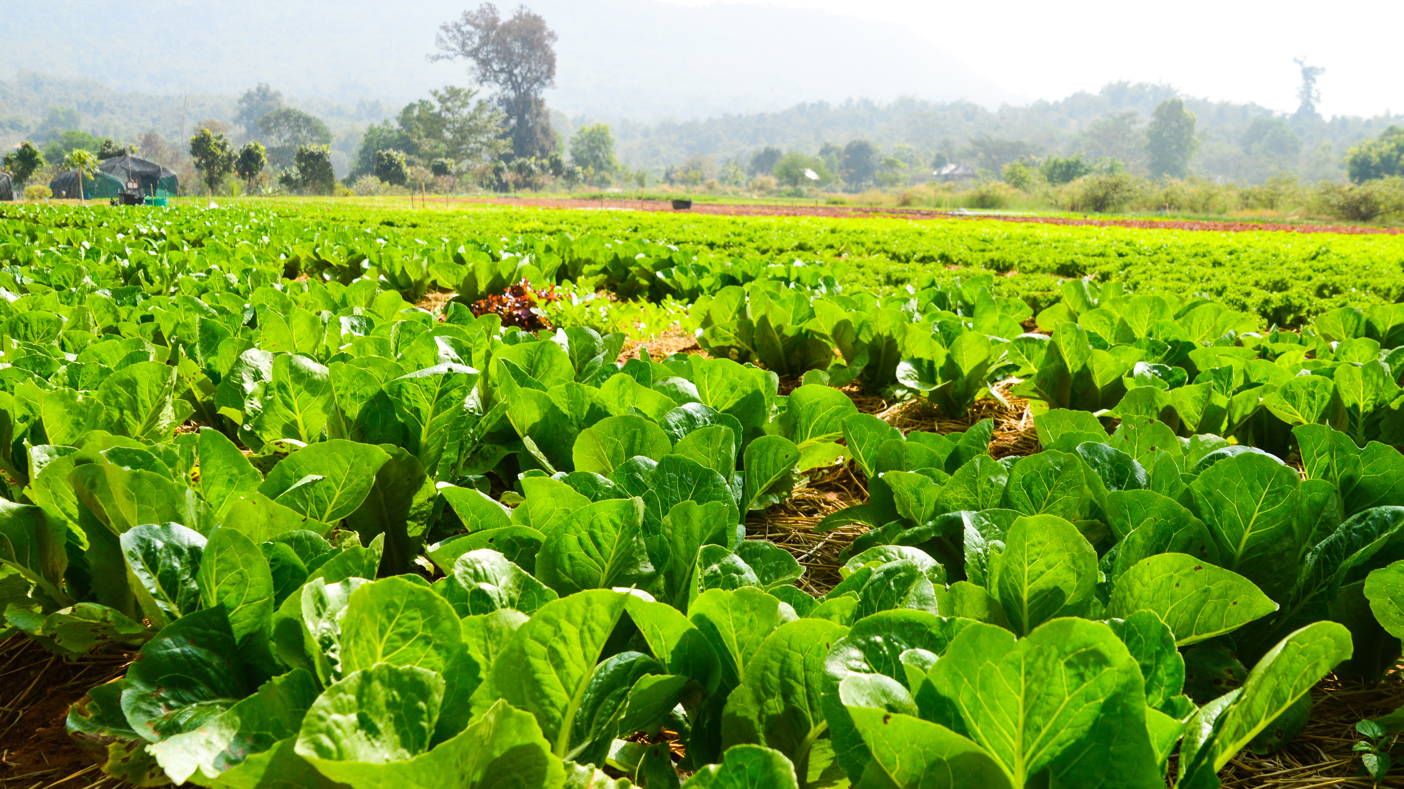
SFMNP SoliMarket
Mobile app for farmers and cashiers
Available through the apple store or google play
Free to download and use
Activation is through invitation only for farmers and cashiers authorized by SFMNP Coordinator or Branch Manager
Link to activate account is emailed to user
Farmer/Vendor needs to enter banking information for deposits
Mobile devices must have a working network connection to perform transactions
Geofencing only allows transactions to be made at designated markets
25

Slide 9
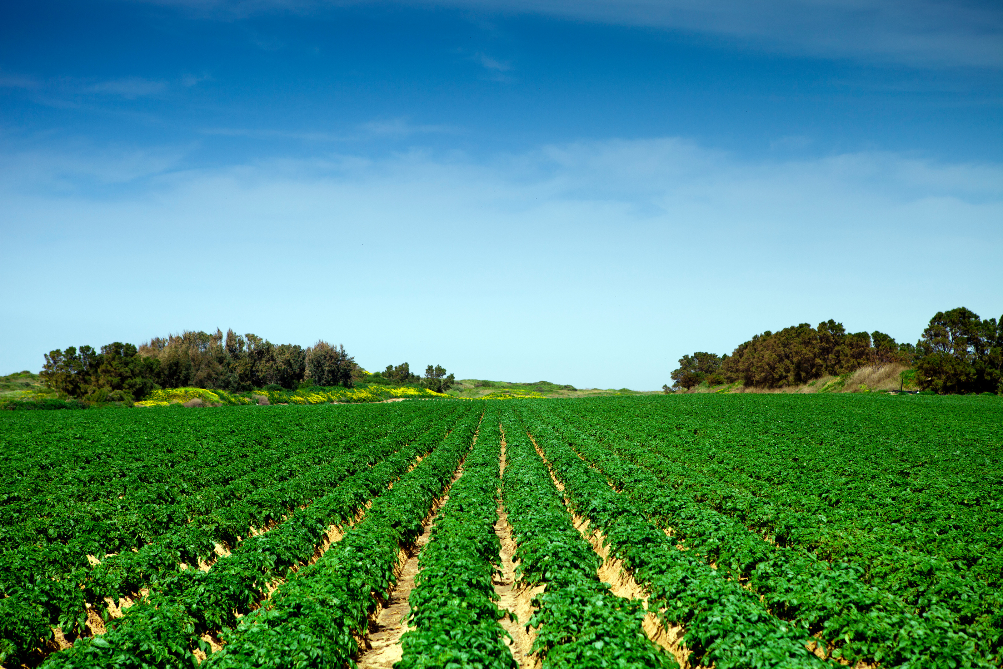
Distribution Agents Procedures
Accept and review all senior applications for eligibility. Qualifying applications must be signed, dated and kept on file. (Do not send us senior applications)
Proxy forms must be filled out and signed by any seniors requesting a proxy or proxies.(New this year! A separate proxy form is no longer needed. The designation of proxy line on the senior application is sufficient)
One senior per card (no couples cards). If a couple qualifies, each senior receives his/her own card.
Each senior (or proxy) must sign the issuance log at time of card issuance. The issuance log is due via email to KDA’s SFMNP Coordinator or Branch Manager by September 1st of program year.

Slide 10
Distribution Agents Procedures
Only distribute according to budgeted amount. This can be monitored via the portal dashboard. As benefits are distributed, total available funding should decrease. This may not be in real time and refreshing may be necessary.
DA’s will be able to load benefits on cards that seniors used last year.
Please maintain a waitlist and send the SFMNP Coordinator or Branch Manager a request as such. Should funds become available, they will be distributed first come, first served, by date/time stamp of your waitlist request email.

Slide 11
Distribution Agency Dates
April
1
September
1
May
1
October
31
Contract due to KDA
Issuance Log due to KDA
Start of SFMNP season
End of SFMNP season

Slide 12
SoliMarket Portal
Website for distribution agents to assign benefits to qualifying seniors.
Activation is through invitation only for distribution agents authorized by SFMNP Coordinators or Branch Manager. A link to activate an account is emailed to user.
Geofencing only allows seniors and/or proxies to make transactions at designated markets.

Slide 13
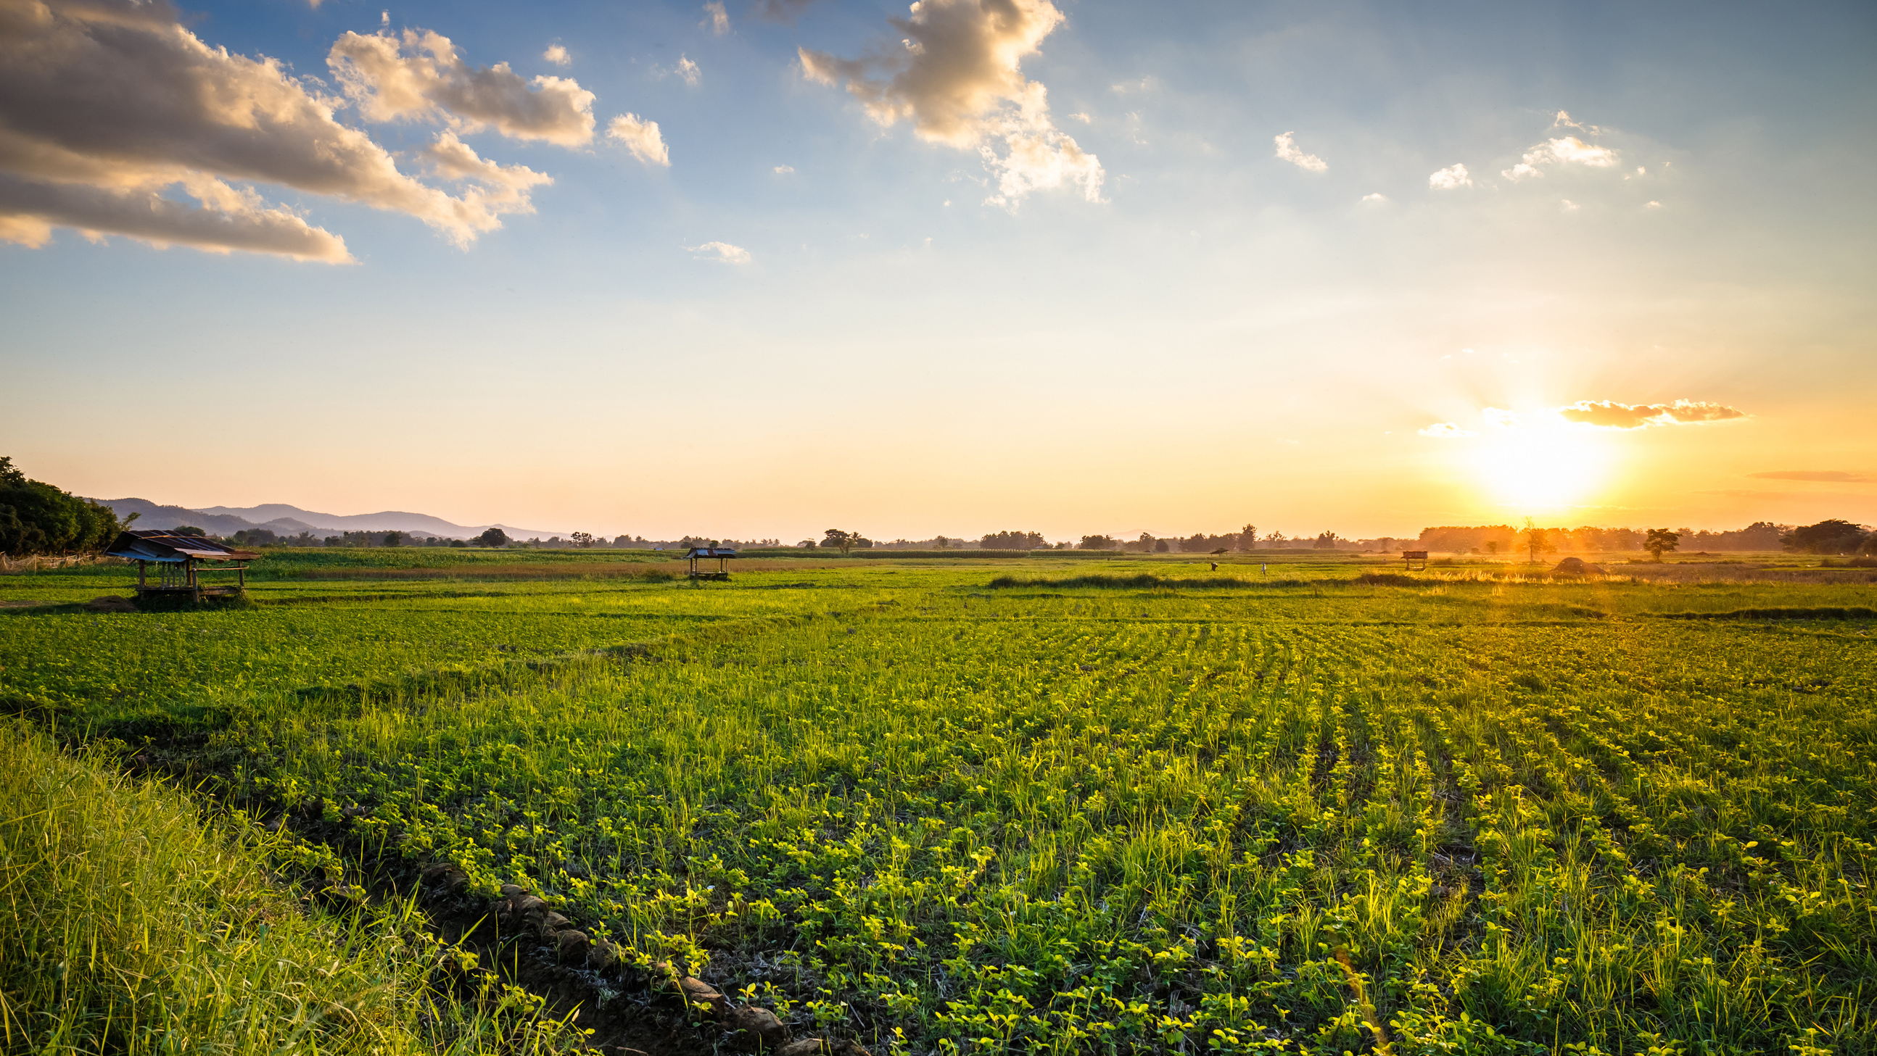
Benefit Cards
The shopper card is similar in form to a standard credit/debit card.
It is custom printed according to the state requirements.
Each card is unique with a 16-digit account number and QR code.
The 2-digit code (number) above the 16-digit card number is required to be entered into the computer application. Also the entire number needs to be on the application/eligibility form and issuance log.
25

Slide 14
Benefit Cards
The card is secured with a participant PIN code. The participants PIN code will be the last 4 digits of the 16-digit number.
To use, the senior or proxy will give to the farmer/vendor to scan the QR code with their device containing the app.
Transaction may be in any amount, up to the dollar value of benefits on the card. The transaction does not have to be in whole dollar amounts.
25

Slide 15
SOLIMARKET RESOURCES
SoliMarket support hotline: 214.256.3083

Slide 16
Civil Rights
In accordance with federal civil rights law and U.S. Department of Agriculture (USDA) civil rights regulations and policies, this institution is prohibited from discriminating on the basis of race, color, national origin, sex, disability, age, or reprisal or retaliation for prior civil rights activity.
Program information may be made available in languages other than English. Persons with disabilities who require alternative means of communication to obtain program information (e.g., Braille, large print, audiotape, American Sign Language), should contact the responsible state or local agency that administers the program or USDA’s TARGET Center at (202) 720-2600 (voice and TTY) or contact USDA through the Federal Relay Service at (800) 877-8339.
To file a program discrimination complaint, a Complainant should complete a Form AD-3027, USDA Program Discrimination Complaint Form which can be obtained online at: https://www.usda.gov/sites/default/files/documents/USDA-OASCR%20P-Complaint-Form-0508-0002-508-11-28-17Fax2Mail.pdf, from any USDA office, by calling (866) 632-9992, or by writing a letter addressed to USDA. The letter must contain the complainant’s name, address, telephone number, and a written description of the alleged discriminatory action in sufficient detail to inform the Assistant Secretary for Civil Rights (ASCR) about the nature and date of an alleged civil rights violation. The completed AD-3027 form or letter must be submitted to USDA by:
1. mail:
U.S. Department of Agriculture
Office of the Assistant Secretary for Civil Rights
1400 Independence Avenue, SW
Washington, D.C. 20250-9410; or
2. fax:
(833) 256-1665 or (202) 690-7442; or
3. email:
program.intake@usda.gov This institution is an equal opportunity provider.

Slide 17
Questions?

Slide 18
www.kyagr.com
Kentucky Department of Agriculture
Division of Food Distribution
107 Corporate Drive
Frankfort, KY 40601
502.573.0282
SFMNP Coordinators:
Jesse Frye, Jesse.Frye@ky.gov Cell: 502.382.7458
Branch Manager
Tina Garland, Tina.Garland@ky.gov Cell: 502.382.7505
Kentucky WIC Program
275 East Main Street, HS2W-D
Frankfort, KY 40601
WIC FMNP Coordinator Alan Peck, Alan.Peck@ky.gov Cell: 502.545.9438

