Slide 1
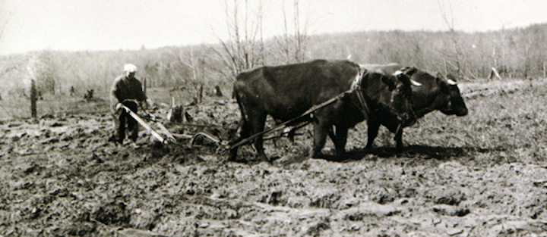
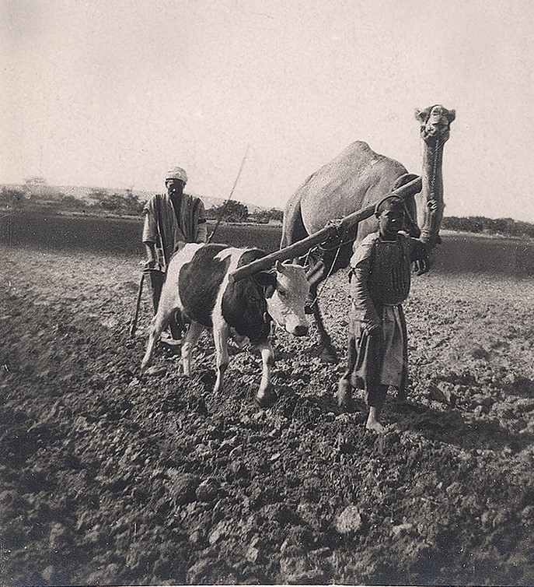
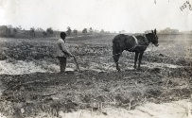
Over 4000 years ago, basic hand-held tools soon developed into simple 'scratch' ploughs. These primitive ploughs were pulled by oxen, camels or even elephants.

Slide 2
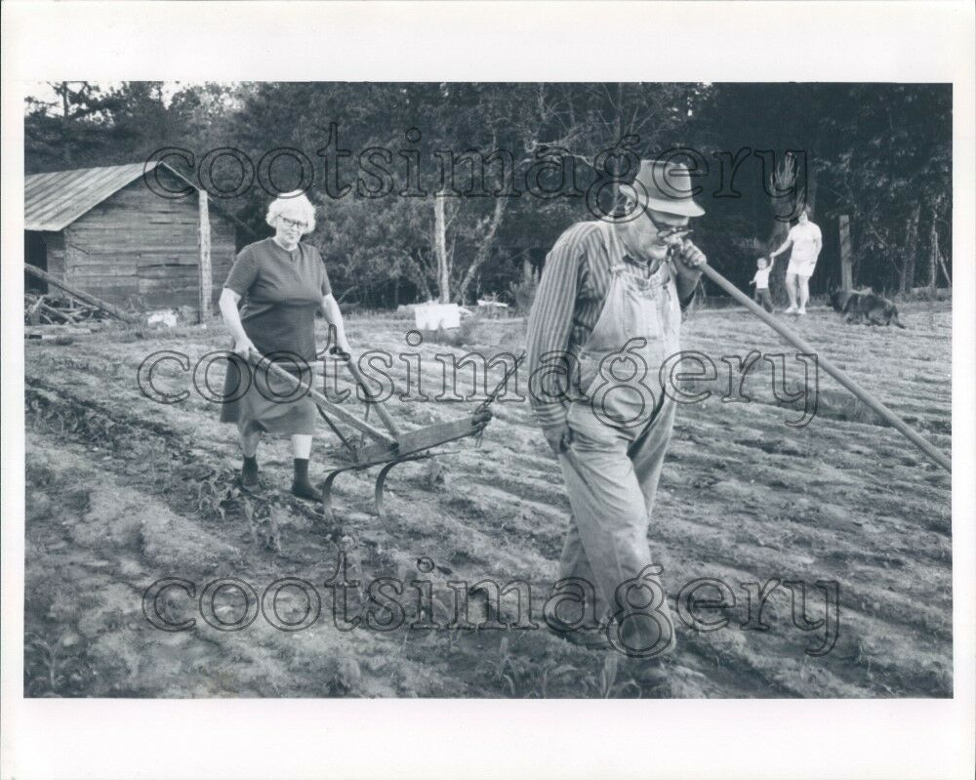
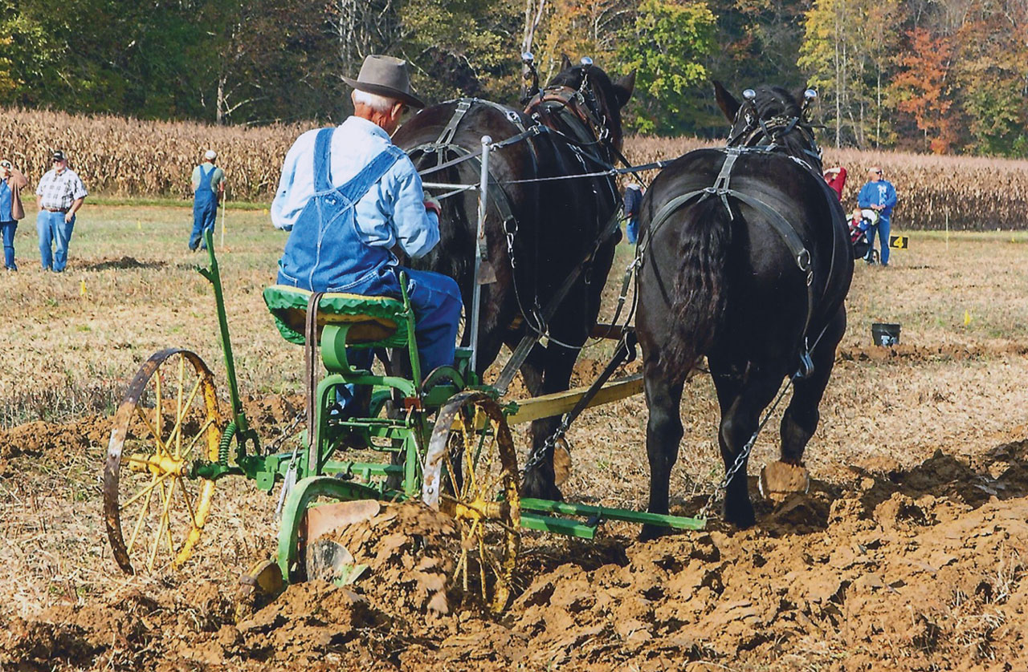
Next we moved to the comfort of riding behind the team …….
And in some instances even their men folk were used…….

Slide 3
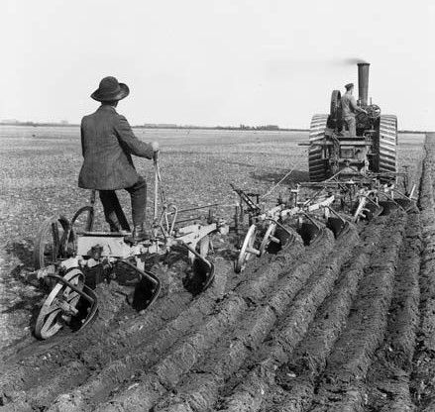
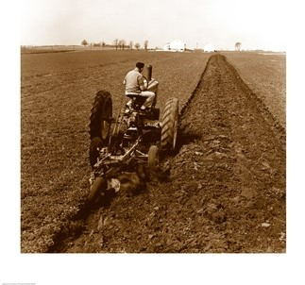
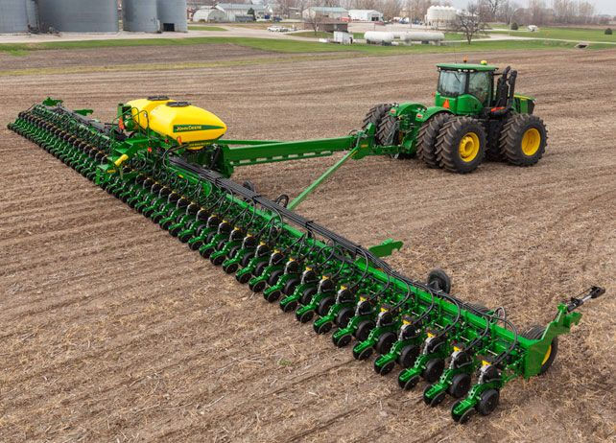
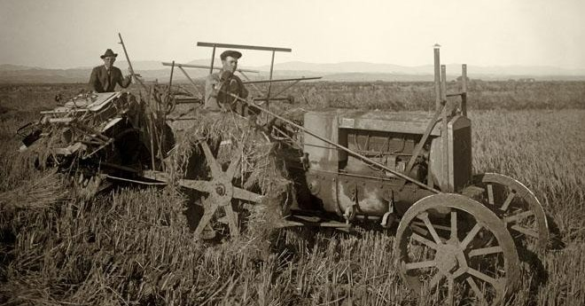
And they became BIGGER…..
Then came the ultimate….

Slide 4
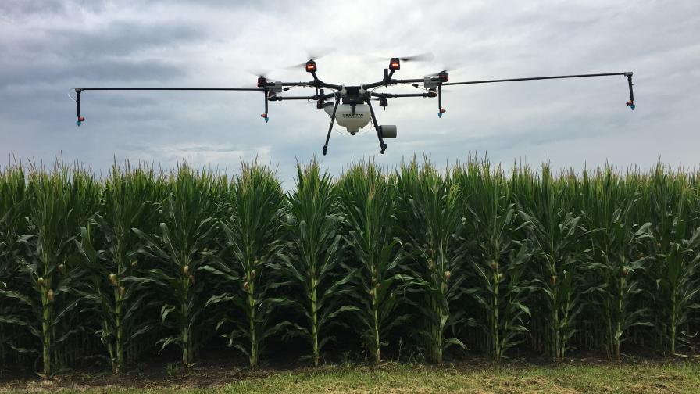
Now in some cases or circumstances we do not even touch the ground to farm at all!!

Slide 5
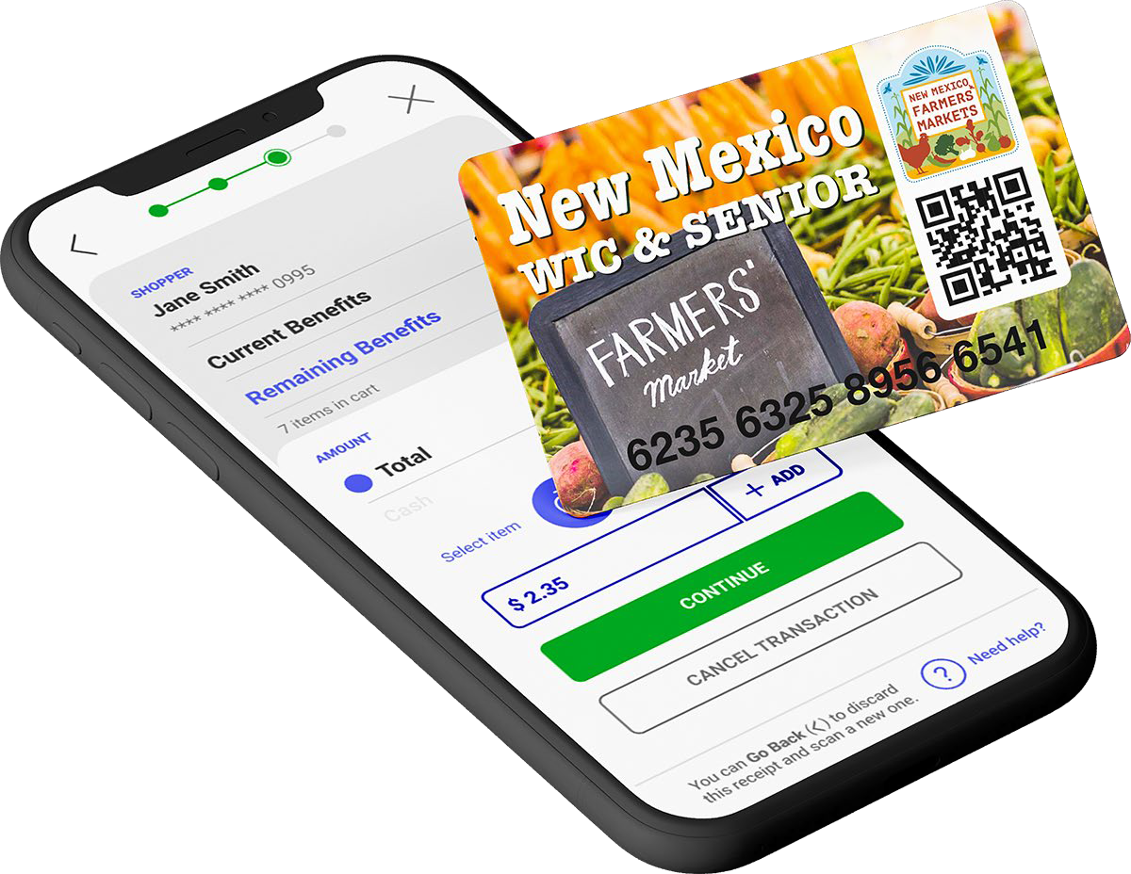
A NEW DAY FOR SFMNP
KENTUCKY
A Mobile Application
to Replace
Paper Vouchers

Slide 6
WHY??
BANKS WILL NO LONGER PROCESS PAPER FOOD INSTRUMENTS/CHECKS FOR WIC-FMNP OR SFMNP. WHY?
AS OF DEC 31, 2020 USDA MANDATED WIC TO GO ELECTRONIC.
WIC AND SENIOR FMNPS TOGETHER ONLY $40 MILLION
NO LONGER RIDE THE COAT TAILS OF A $787 BILLION WIC PROGRAM NOW THAT IT IS ELECTRONIC.

Slide 7
FARMERS ARE REQUIRED TO HAVE EMAIL ADDRESS – WHAT IF I DO NOT HAVE ONE?
FARMER CALLS SOLISYSTEMS SUPPORT LINE (214-256-3083). DO NOT CALL HELP LINE FROM THE MOBILE DEVICE YOU WILL DOWNLOAD APP TO
SOLISYSTEMS CREATE A GMAIL ACCOUNT FOR THE FARMER
THE SOLIPORTAL WILL SEND THE INVITATION CODE TO THAT EMAIL
SOLISYSTEMS SUPPORT LINE STAFF WILL RECEIVE THAT EMAIL AND VERBALLY GIVE THE INVITATION CODE TO THE FARMER AND WALK THEM THROUGH ACTIVATION
THE EMAIL WOULD STAY IN THE SOLIPORTAL AS A REQUIRED DATA FIELD
IF THE FARMER WAS WILLING – SOLISYSTEMS WILL LET HIM TAKE THAT EMAIL ACCOUNT OVER AND USE IT NORMALLY. UP TO THEM…

Slide 8

SOLIMARKET REGISTER - MOBILE APP FOR FARMERS AND APPROVED CASHIERS
EACH FARMER AND CASHIER DOWNLOADS SOLIMARKET REGISTER
•AVAILABLE THROUGH THE APPLE STORE OR GOOGLE PLAY
•IT IS FREE TO DOWNLOAD- AND FREE TO USE
•NO CHARGES TO FARMERS OR THE STATE FOR THIS APPLICATION
•ACTIVATION IS THROUGH INVITATION ONLY – FOR PRE-AUTHORIZED FARMERS/CASHIERS
•SUPPORTS BOTH PHONES AND TABLETS
•MOBILE DEVICES MUST HAVE A WORKING NETWORK CONNECTION TO PERFORM TRANSACTIONS

Slide 9
CONT’D MOBILE APP FOR FARMERS AND APPROVED CASHIERS
SOLIMARKET REGISTER IS A TRUE MOBILE APPLICATION
•THIS MEANS IT IS STABLE, EASY TO ACCESS AND SECURE
•IT LOADS INSTANTLY AND FAST AND EFFORTLESS LOGIN
•THE APPLICATION HAS AUTOMATIC ACCESS TO THE CAMERA TO QUICKLY SCAN QR CODES
•THE REGISTER APPLICATION IS ABLE TO USE THE PHONES LOCATION SERVICE TO QUICKLY IDENTIFY THE CORRECT MARKET

Slide 10
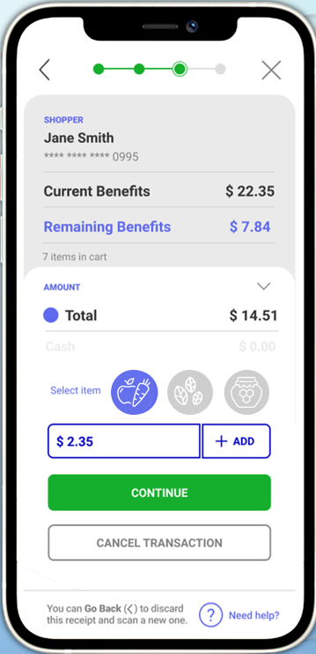
SOLIMARKET REGISTER – MOBILE APP FOR FARMERS CASHIERS
•SUPPORTS MULTIPLE ‘CASHIERS’ ON MULTIPLE DEVICES, IN MULTIPLE LOCATIONS AT THE SAME TIME
•EACH CASHIER HAS A UNIQUE LOGIN AND USER ID- WHICH IS RECORDED TO EACH TRANSACTION
•CASHIERS ARE CREATED VIA SOLIPORTAL FOR SECURITY
•ACTIVATION REQUIRES A VALIDATION CODE FROM THE STATE- FARMERS/CASHIERS
MUST BE PRE-APPROVED TO ACTIVATE SOLIMARKET REGISTER
•REMITTANCES ARE AUTOMATIC
•PAYMENTS TO FARMERS ARE MADE WEEKLY BY ACH TRANSFER
•FARMERS DO NOT NEED TO DO ANYTHING TO INITIATE THEIR PAYMENT
•FARMERS CAN VIEW SALES AND PENDING PAYMENT
•TRANSACTIONS ARE FAST AND SIMPLE
•LESS THAN 1 MIN START TO FINISH

Slide 11
Settlement conditions are validated at the time of sale.
Compliance with FNS and state program rules is validated before the transaction is confirmed. Here are some of the common verifications done by SoliMarket:
Verifies balance & benefit expiration date.
•Ensures that benefits are within valid start and expiration dates for participant utilization. “Valid thru” dates are set at time of issuance.
•Verifies food categories.
•Food categories are recorded to transaction history.
•Program rules are checked to ensure selected food categories are approved
for by program for utilization.
Verifies status of farm and selected market.
•Farmers must be currently authorized by state.
•Markets must be authorized by state.
Validates time of transaction
•Sales are restricted to pre-defined hours of operation.
Validates participant transaction acceptance and PIN.

Slide 12




Funding Flow
BENEFIT ISSUANCE
FARMERS’ MARKET PURCHASES
TRANSACTION SETTLEMENT
PROGRAM FUNDING
REMITTANCE
SoliMarket Shopper
Account
SoliMarket Shopper Application
SoliMarket Register Application
SoliMarket Backend
SoliMarket Admin
State Account
SoliMarket Program
Account
SoliMarket Program
Account
Farmer A
Account
Shopper
Shopper
Farmer A
Farmer A
WIRE TRANSFER
ACH TRANSFER
Shopper 1: $60
Shopper 2: $60
Shopper 1: ($20 Purchase)
Shopper 2: ($30 Purchase)
+ $20
+ $30
Approved
Approved
+ $20
+ $30
Remittance ACH File Created
Remittance ACH File Created
Weekly ACH Batch File Created
SoliSYSTEMS Invoice to Agency
Invoice Amount
Farmer A Remittance = $20
Farmer A Remittance = $30
1
BENEFIT ISSUANCE
2
FARMERS’ MARKET PURCHASES
3
TRANSACTION SETTLEMENT
4
PROGRAM FUNDING
5
REMITTANCE
Agency Users
Shoppers & Farmer-Cashiers
SoliMarket Backend
SoliSYSTEMS Admin
Agency Financial Admin
SoliMarket Admin
Agency Users log into the SoliPortal to enroll participant shoppers and issue funds to their accounts.
Participant Shoppers use the SoliMarket Shopper app or Shopper Card to purchase eligible food items from authorized farmers who are using the SoliMarket Register application.
SoliSYSTEMS Admin uploads weekly ACH Remittance Files. These files contain the instructions and schedule for initiating the transfer of funds to each farmer’s bank account.
SoliSYSTEMS Admin generates an invoice/report documenting the pending use of funds for remittance payments.
Agency Administrator(s) reviews and approves invoice and transfers funds to the SoliMarket Program Account via manually initiated wire transfer.
The SoliMarket Program Account is a standard FDIC insured account.
Initiates weekly ACH Remittance batch files from the SoliMarket Program Account.
Funds are transferred directly to Farmer’s accounts.
The first steps of settlement are done before the transaction is completed at the point of sale.
Confirmation of the Shopper’s account and balance.
Confirmation of the Farmer’s SoliMarket Account and contract validity.
Confirmation of a valid Market code and contract validity.
Confirmation of Shopper’s acceptance of the transaction details.

Slide 13

BENEFIT CARD – FOR SENIORS
THE SHOPPER CARD IS SIMILAR IN FORM TO A STANDARD CREDIT/DEBIT CARD
IT IS CUSTOM PRINTED ACCORDING TO THE STATE REQUIREMENTS
EACH CARD IS UNIQUE WITH A 16 DIGIT ACCOUNT NUMBER & QR CODE
THE CARD IS SECURED WITH A PARTICIPANT PIN CODE
ELIGIBLE PARTICIPANTS MAY RE-USE THEIR CARDS FOR MULTIPLE MARKET SEASONS

Slide 14
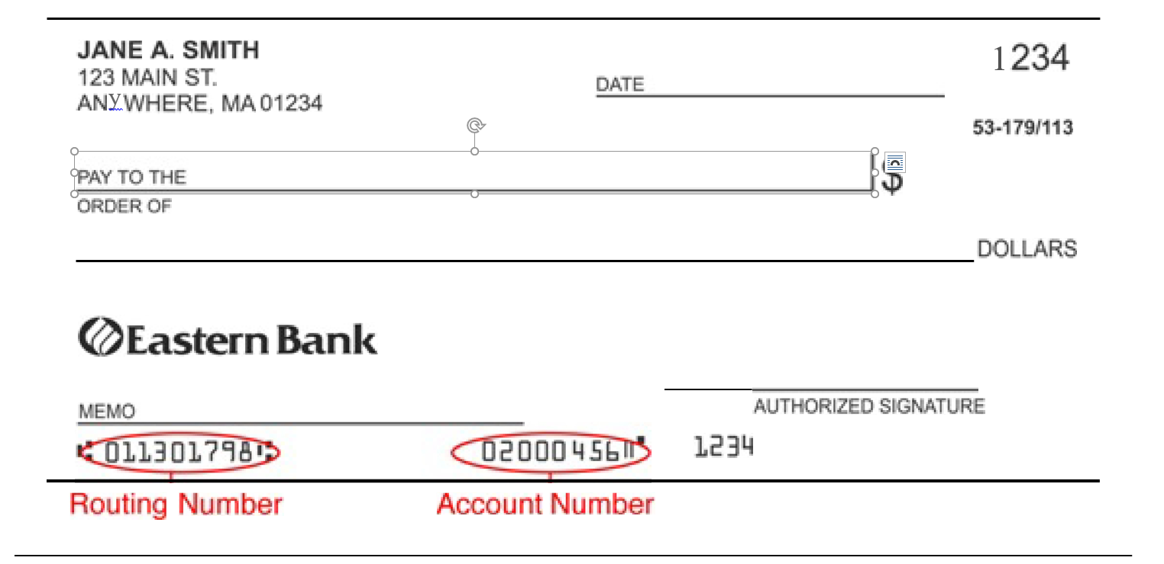

Slide 15
Phone to Phone
https://www.youtube.com/watch?v=VIbpP_C3-Ic
Card to Phone
https://www.youtube.com/watch?v=dLnsi9OwDsI

Slide 16
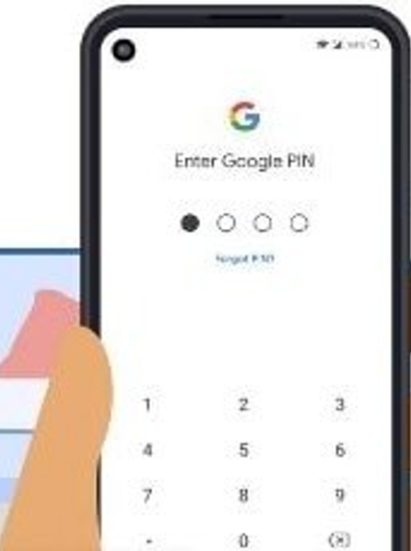
UPDATE TO PIN ENTRY
RECIPIENT WILL ONLY ENTER PIN ONE TIME –
•AFTER THE FARMER HAS ENTERED AMOUNT OF PURCHASE THE RECIPIENT WILL ENTER THEIR PIN # TO CONFIRM THE AMOUNT OF TRANSACTION.
•THE TRANSACTION IS NOW COMPLETE AND FUNDS HAVE BEEN SUBMITTED TO YOUR SOLIMARKET ACCT.

Slide 17

When the senior’s card shows $0 balance
•Inform senior they have used all their money for this season
•Stress to them keep the card in a safe place where they know where it is
•Tell them to keep their card to reuse for SFMNP benefits next year

Slide 18

FAQ’s ON CARDS

Slide 19
FAQ’s ISSUANCE and UTILIZATION

Slide 20
Distribution Agency Responsibilities
Set date of SFMNP card issuance
Advertise date of your SFMNP sign-up
Issue cards
Turn in issuance log by September 1st 2022
Request extra cards for your program should you issue all of your allotted cards
Monitor your SFMNP program via the SoliSystem Dashboard

Slide 21
Farmers Market Managers Responsibilities
Set training dates for farmers
Train farmers and collect farmers applications
Monitor your SFMNP program via the SoliSystems Dashboard

Slide 22
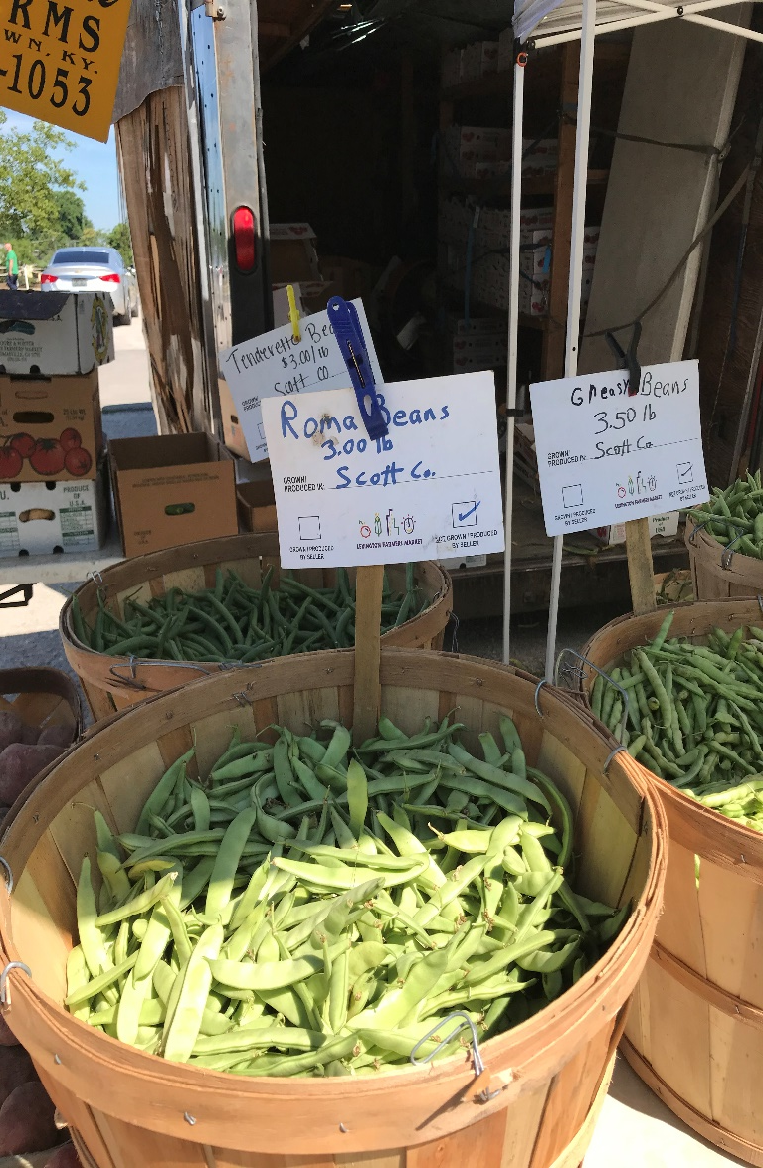
Important Deadlines to Remember
Distribution Agency Dates
May 13th 2022
Contract due to KDA
Sept 1st program year Issuance Log due to KDA
Sept 15th program year return to KDA extra cards your county did not issue
June 1st program year
start of SFMNP season
October 31st program year end of SFMNP season
Famers Market Managers Dates
May 13th 2022
Contract due to KDA
May 31st program year
Last day for farmer applications due to KDA
June 1st program year
start of SFMNP season
October 31st program year
end of SFMNP season

Slide 23
For More Information
Kentucky Department of Agriculture
Division of Food Distribution
107 Corporate Drive
Frankfort, KY 40601
502-573-0282
www.kyagr.com
Senior FMNP Coordinator Jesse Frye, jesse.frye@ky.gov 502-382-7458
Tina Garland, Tina.Garland@ky.gov 502-382-7505
AND
Kentucky WIC Program
275 East Main Street, HS2W-D
Frankfort, KY 40601
WIC FMNP Coordinator Alan Peck alan.peck@ky.gov 502-564-2945

