Slide 1

Jr Chef & Burger Battle
Kentucky Department of Agriculture

Slide 2
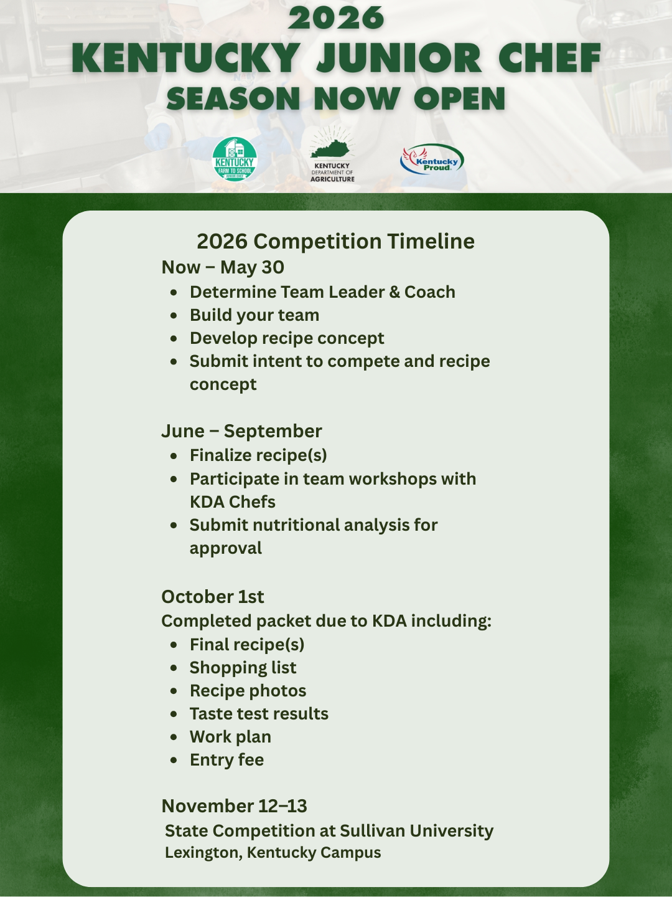
Updated Timeline for 2026
.

Slide 3

NSLP Guidelines:
9-12
FOOD COMPONENT MINIMUM SERVING SIZES
Fruit or Vegetable *Vegetable subgroups: Dark Green, Red/Orange, Bean/Pea or Legumes, Starchy and Other |  | ½ cup (c)
Grains Whole or enriched grains only |  | 2-ounce equivalents (oz eq)
Meat/Meat Alternates |  | 2-ounce equivalents (oz eq)
NUTRITION SPECIFICATION RANGES
Calories (kcal) | Saturated Fat (% of total calories) | Sodium (mg) | Trans Fat (g)
750 – 850 | < 10% | ≤ 1,280 | 0
M/MA
  2oz Eq
Grain
  2oz Eq
  80% WGR
Fruit or Veg: ½ Cup serving
Calories:
  750-850 (based on weekly ave)
Sat Fat:
  Less than 10% calories
Sodium:
  1280mg (current)
Trans Fat:
  ZERO!
Notes:
Lettuce: need 2x the amount

Slide 4
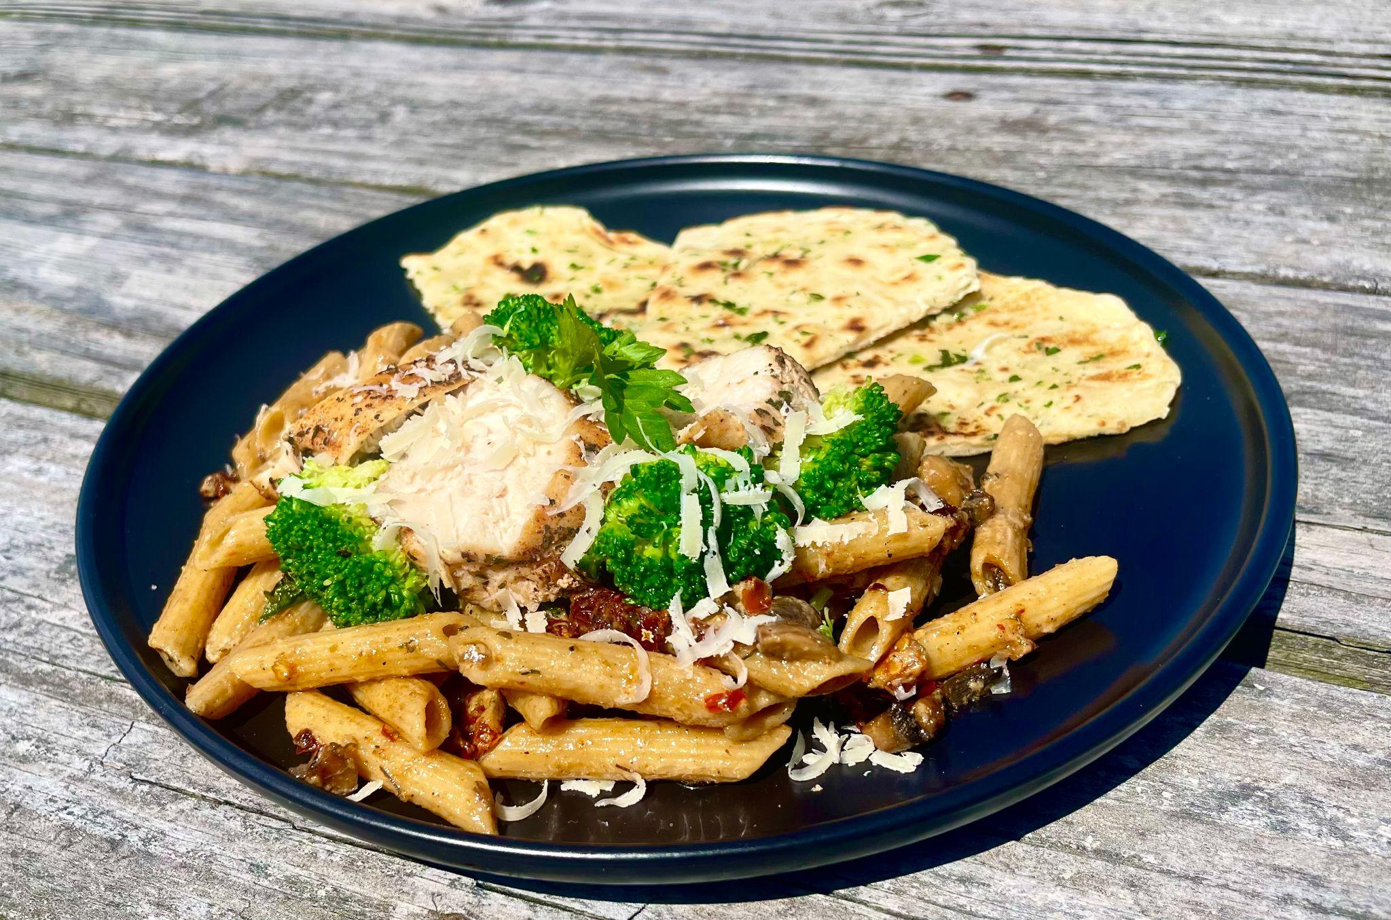
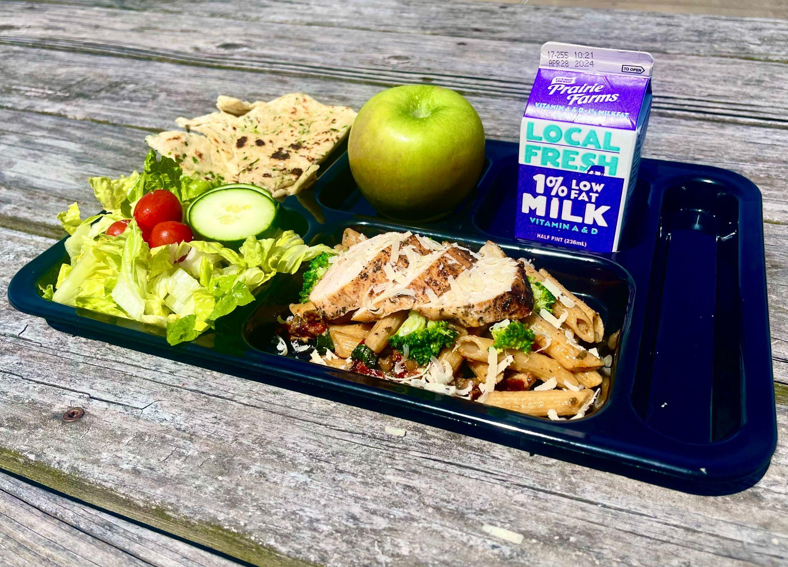
Pictures of Entry
Culinary Presentation
School Lunch Presentation

Slide 5
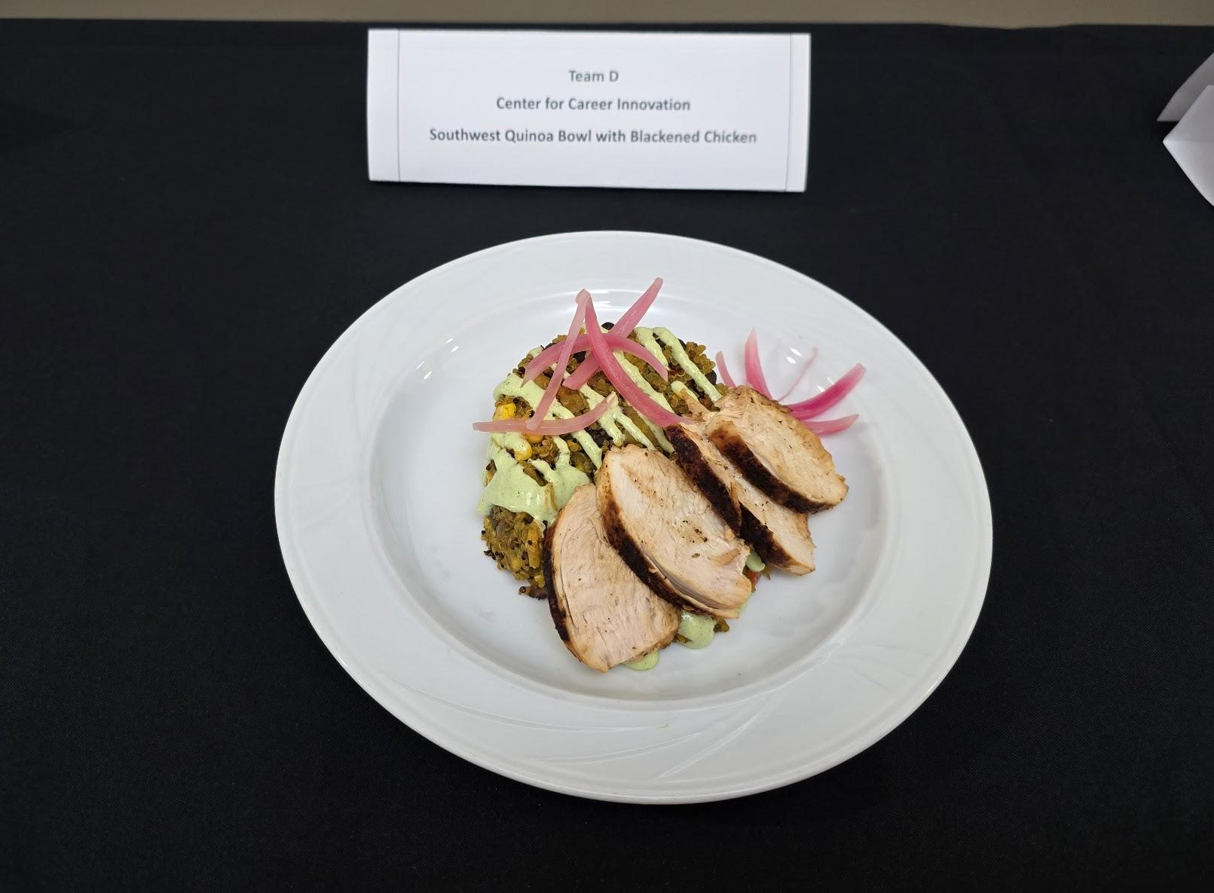
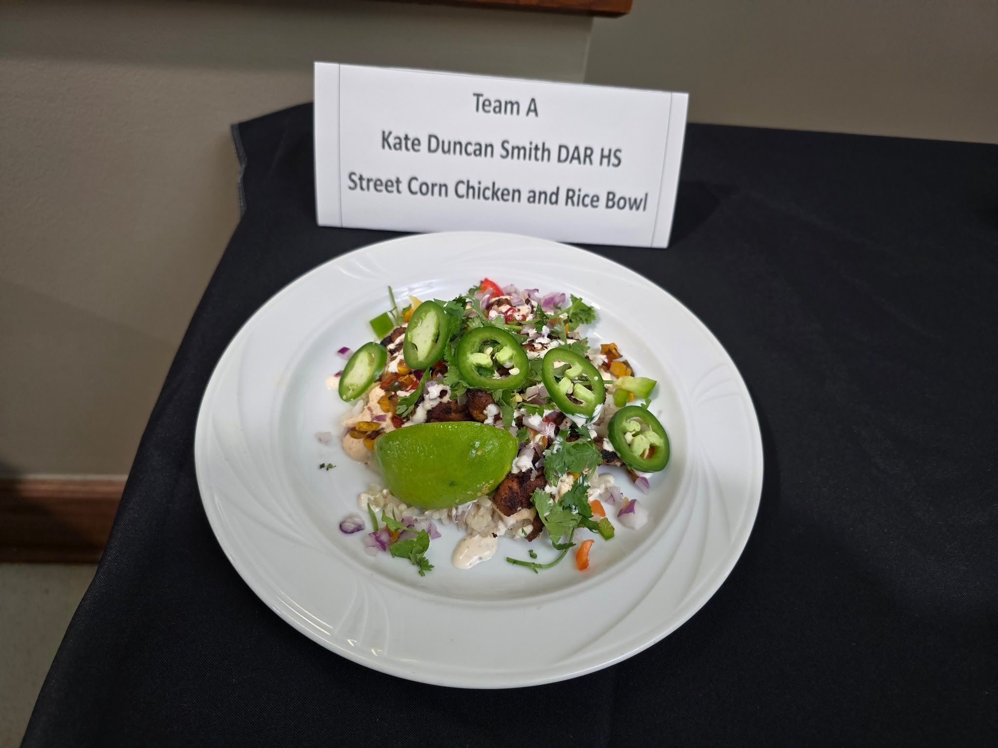
Pictures of Enties
ion

Slide 6
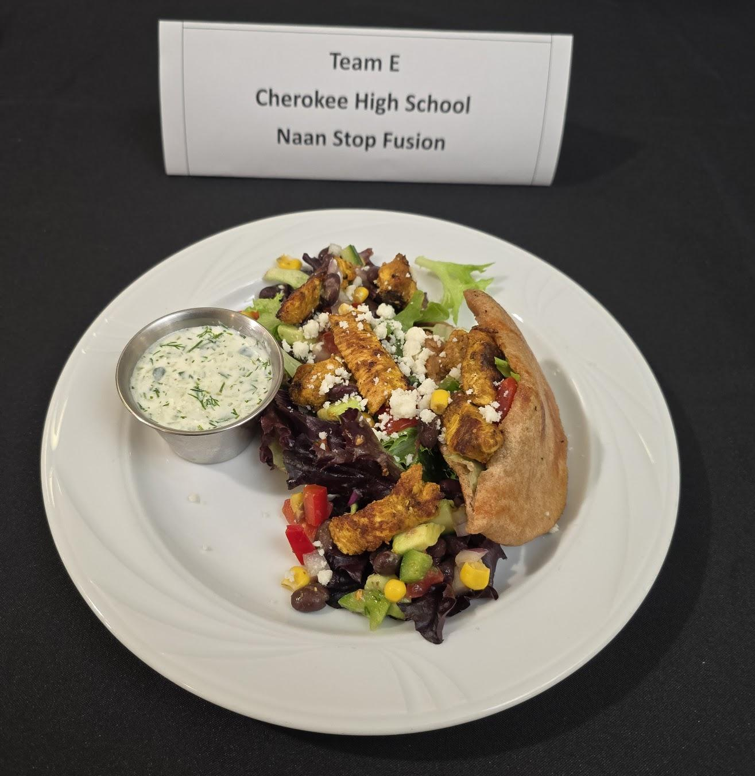
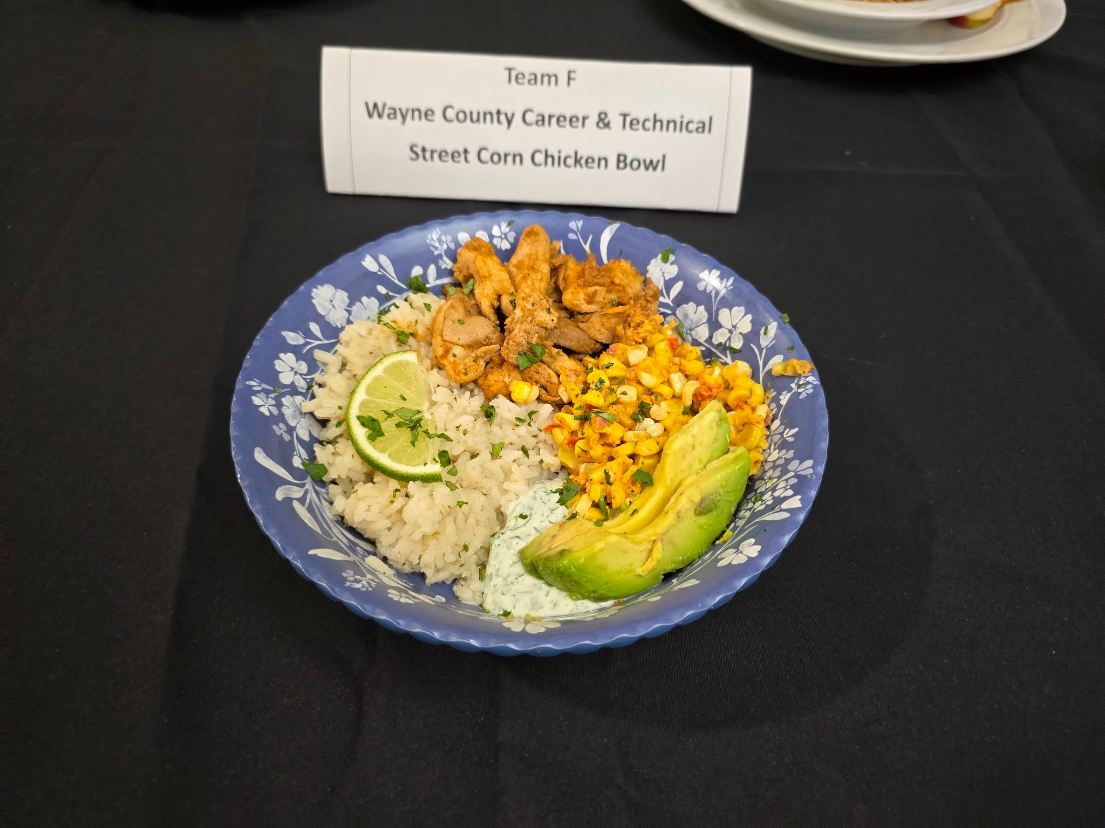
Pictures of Enties
ion

Slide 7
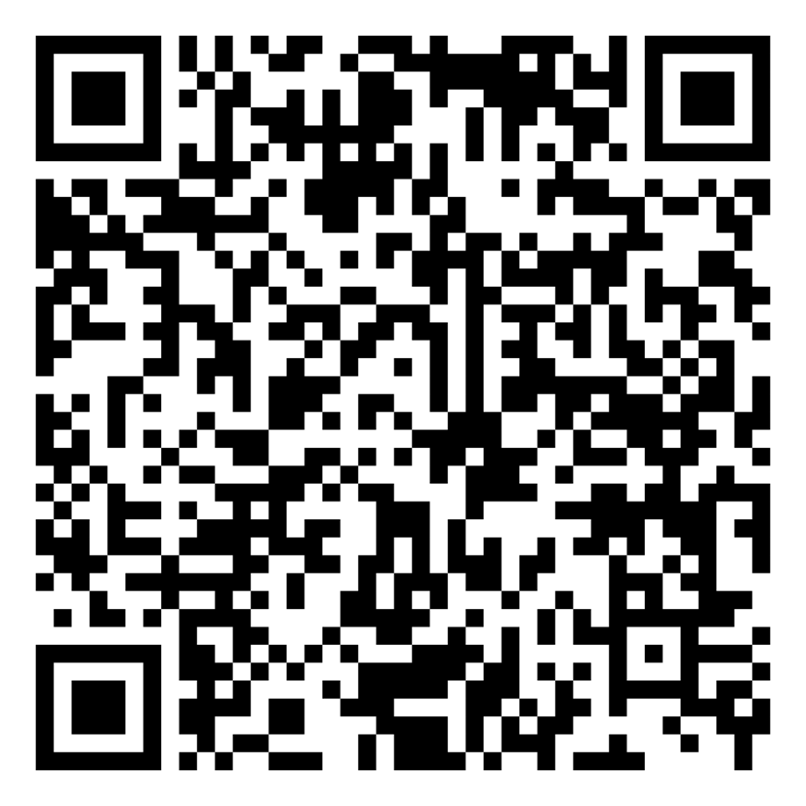
Judging Sheet
New Rubric Style Format!!!

Slide 8
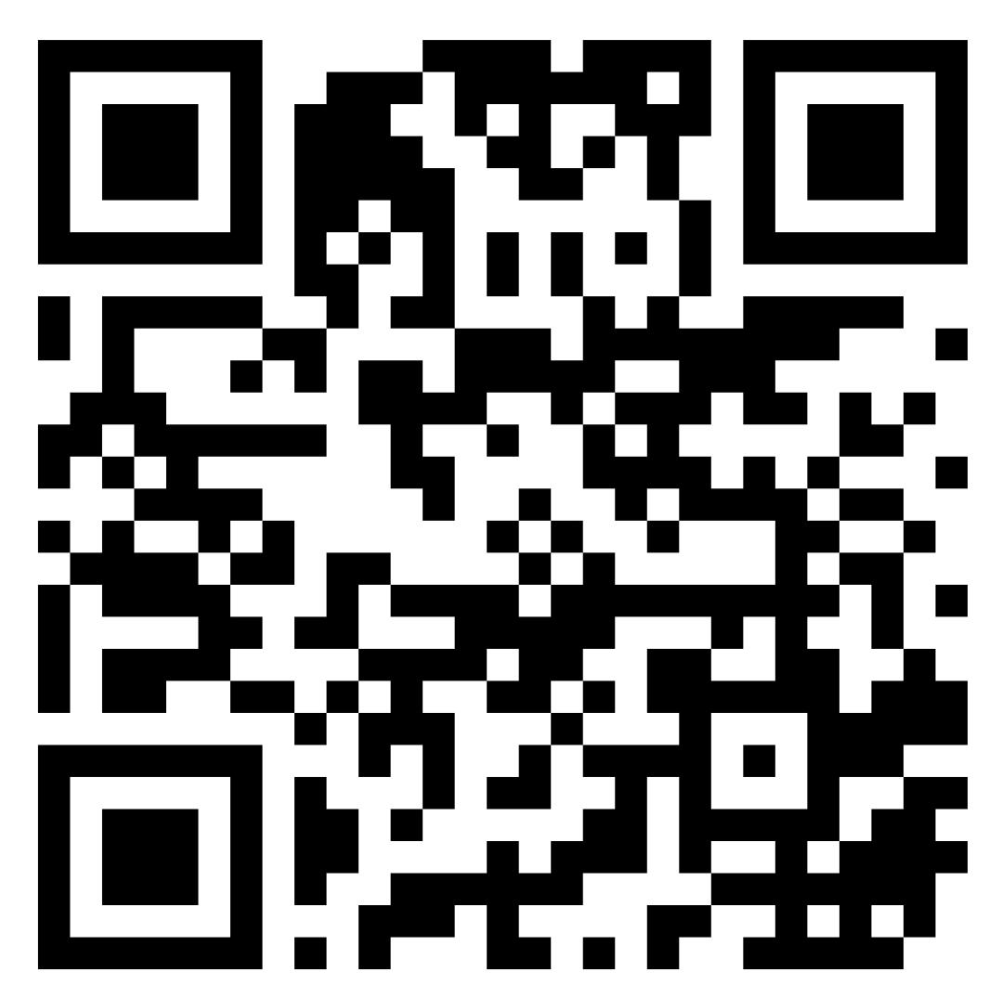
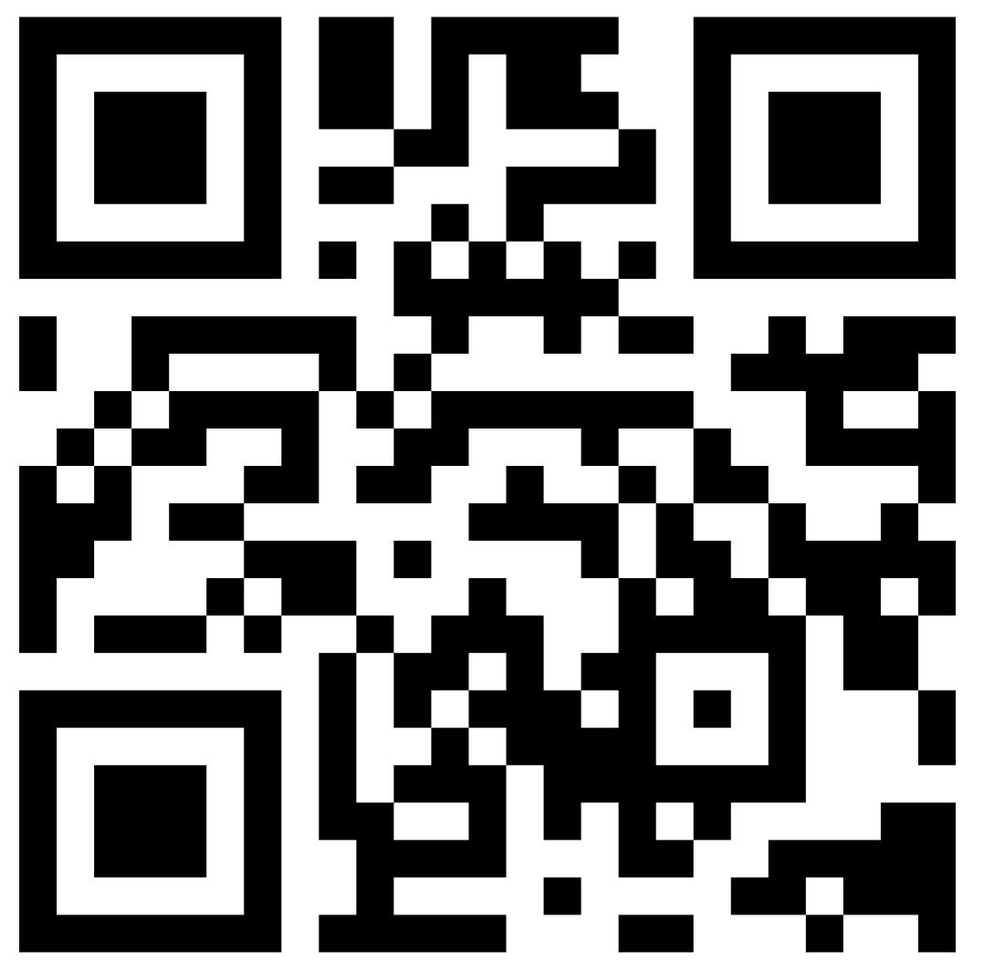
Go to the Jr. Chef Website Here:
http://www.kyagr.com/junior-chef/
Get your Jr. Chef Lesson Plans Here:
www.bit.ly/KDAJrChef

Slide 9


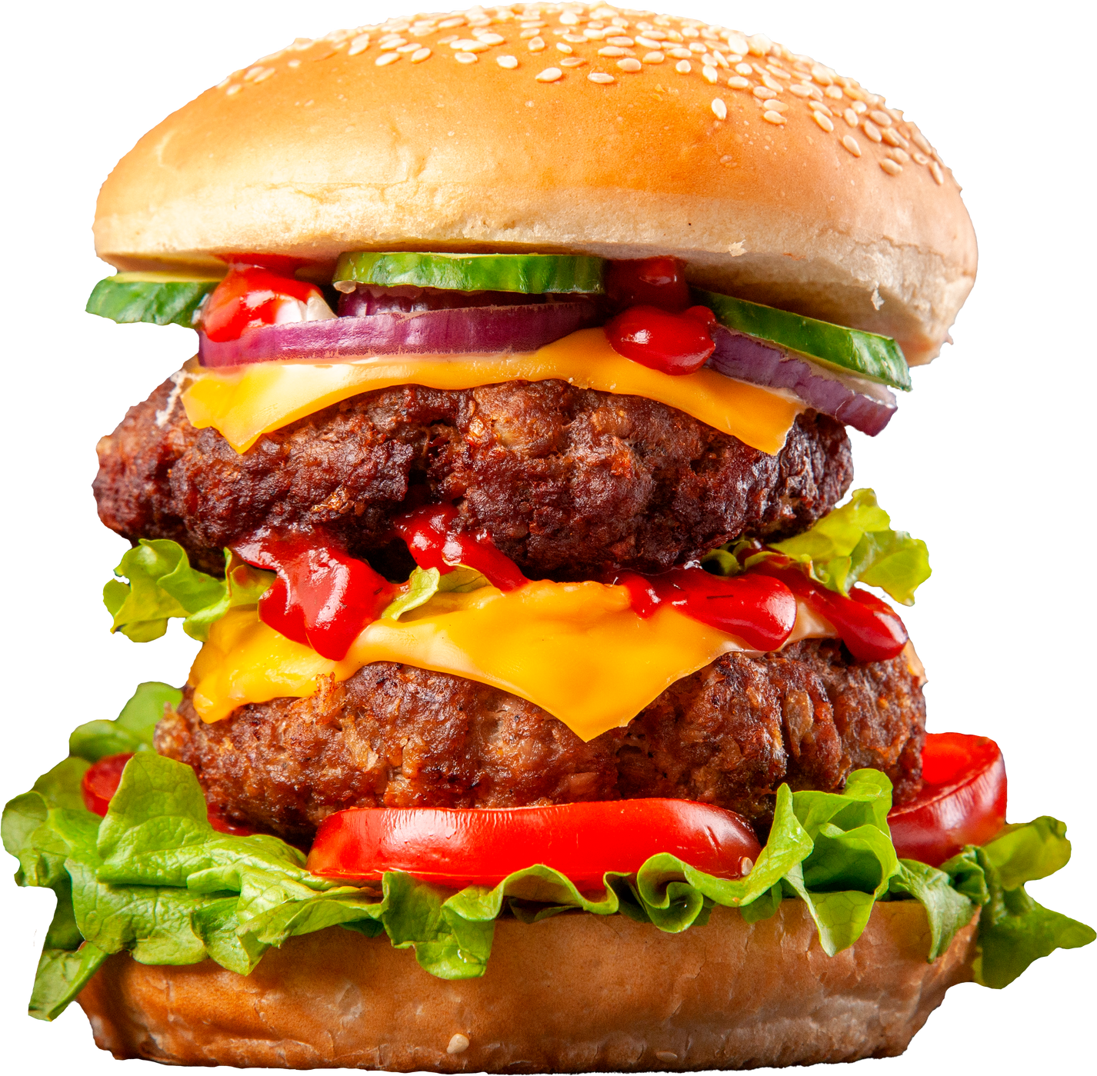



FARM TO SCHOOL MONTH
BURGER BATTLE

Slide 10
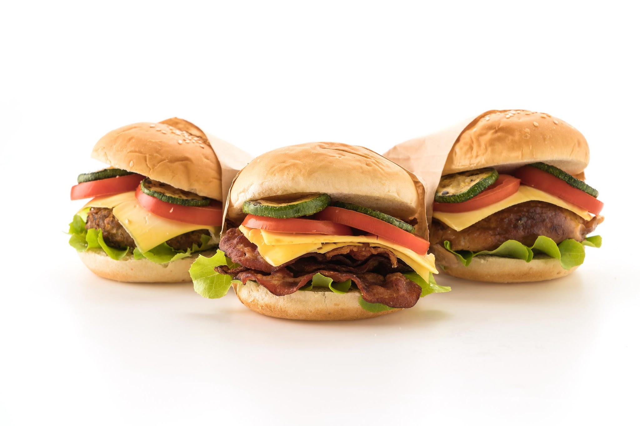
BURGER BATTLE
Submittions Starting Oct 1st Ending Oct 23rd
Not long ago, our ancestors grew and preserved their own food, but now we rely on packaged goods and fast food. We've lost touch with local farmers who provide fresh, high-quality produce. For this competition, research local ingredients in your area and create a burger using these items creatively.

Slide 11
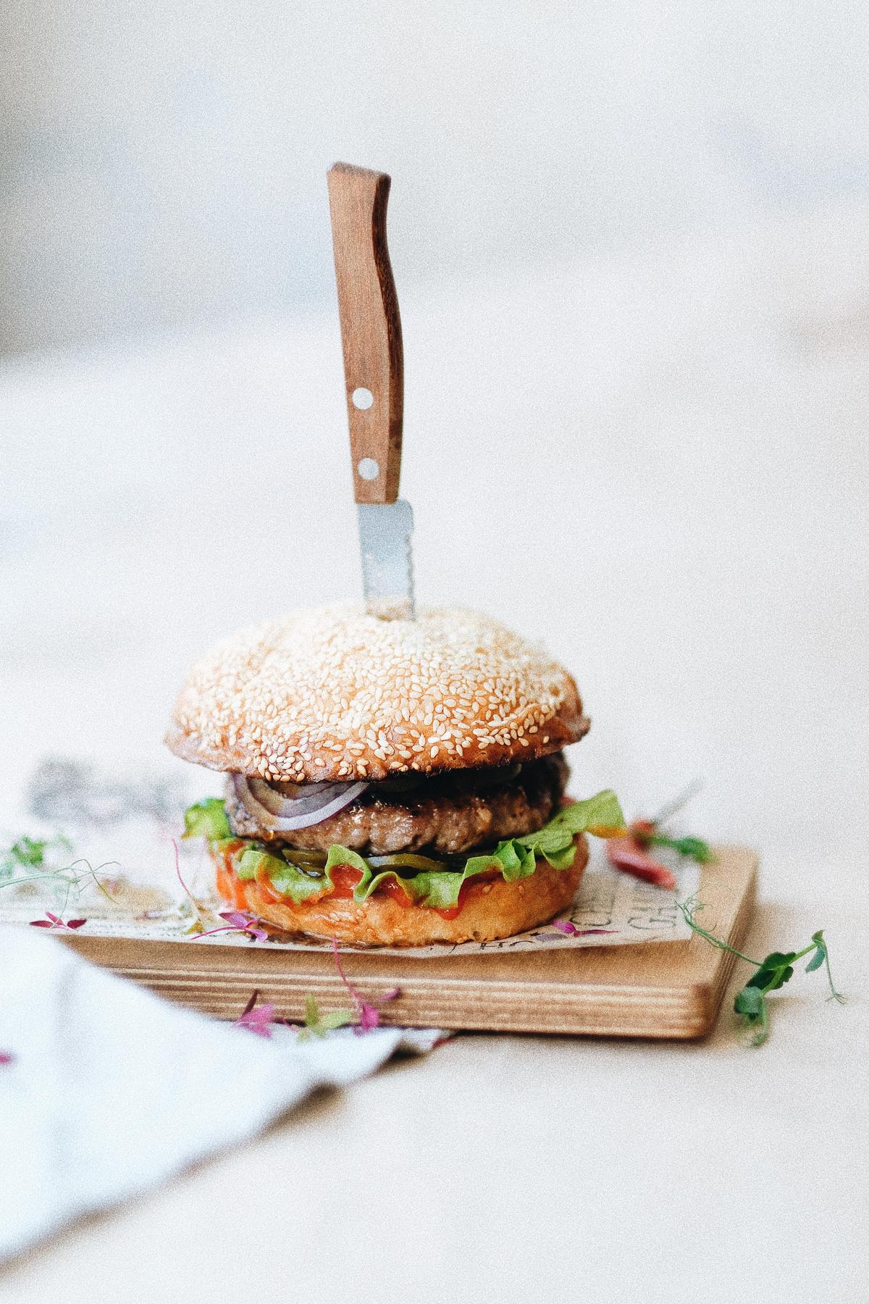
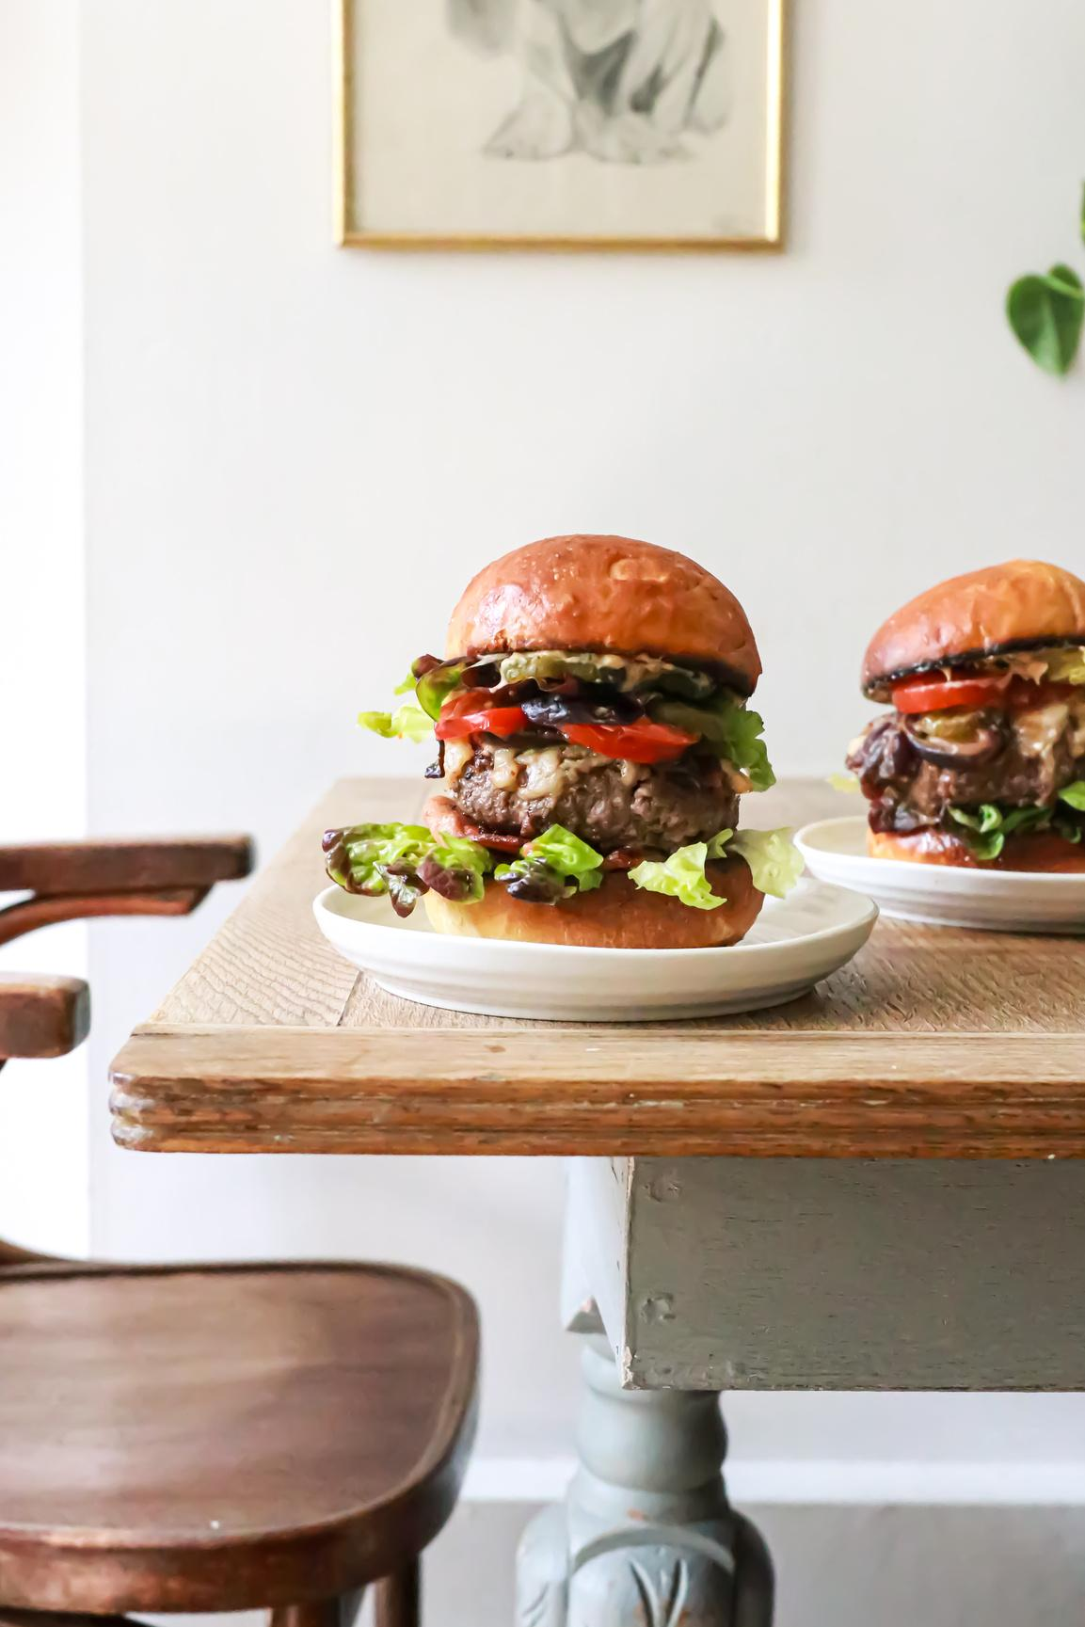
BURGER BATTLE CRITERIA
•Include at least on local ingredient from your county
•Include at least one local ingredient from your surrounding county
•Include at least one Kentucky Proud ingredient
•Burger must include a patty, toppings and “bun” (this can take many forms and could include bread from a local bakery)
•Provide a detailed description that highlights each local product and how it was used on your burger. (include a list of farms or producers you used and what product you chose from each one)
•Create a single page flyer that contains all of the required information that is ready for a restaurant table display (I used Canva)
Submit your completed entry to KDA Chef Shannon Stevens @
shannon.stevens@ky.gov please include Burger Battle in the Title of the Email.

Slide 12
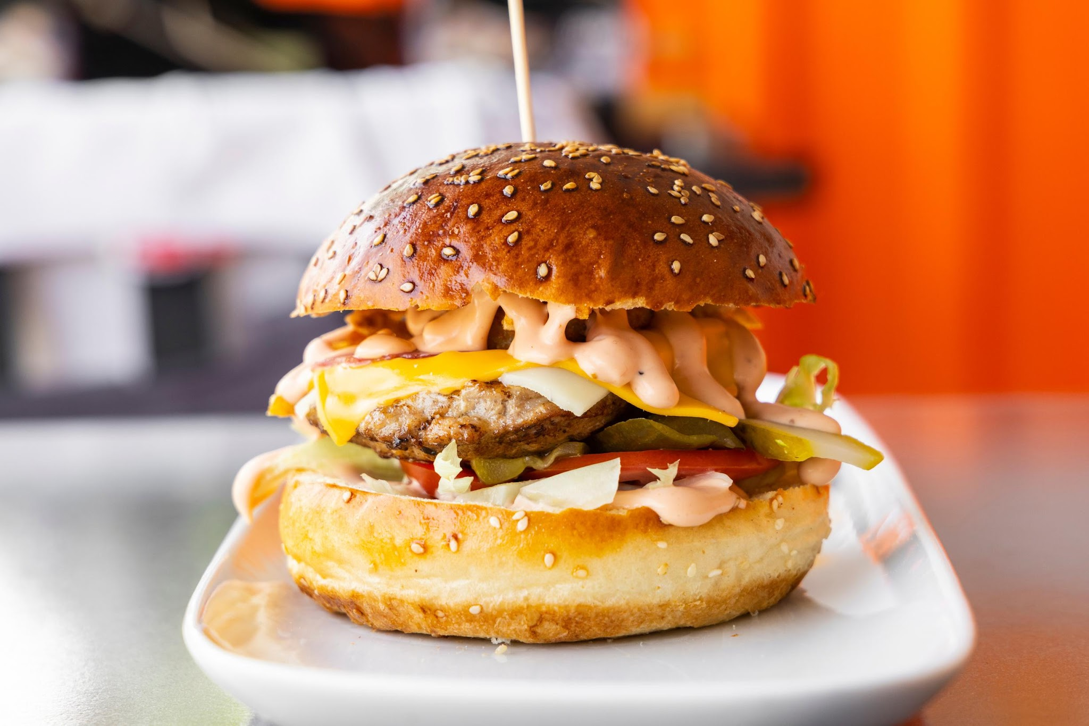
SOURCING LOCAL INGREDIENTS
Starting Point
  Search your Local Farmers Markets
  Spotlight Your Local Vendors
  Know What You're Looking For and Why

Slide 13
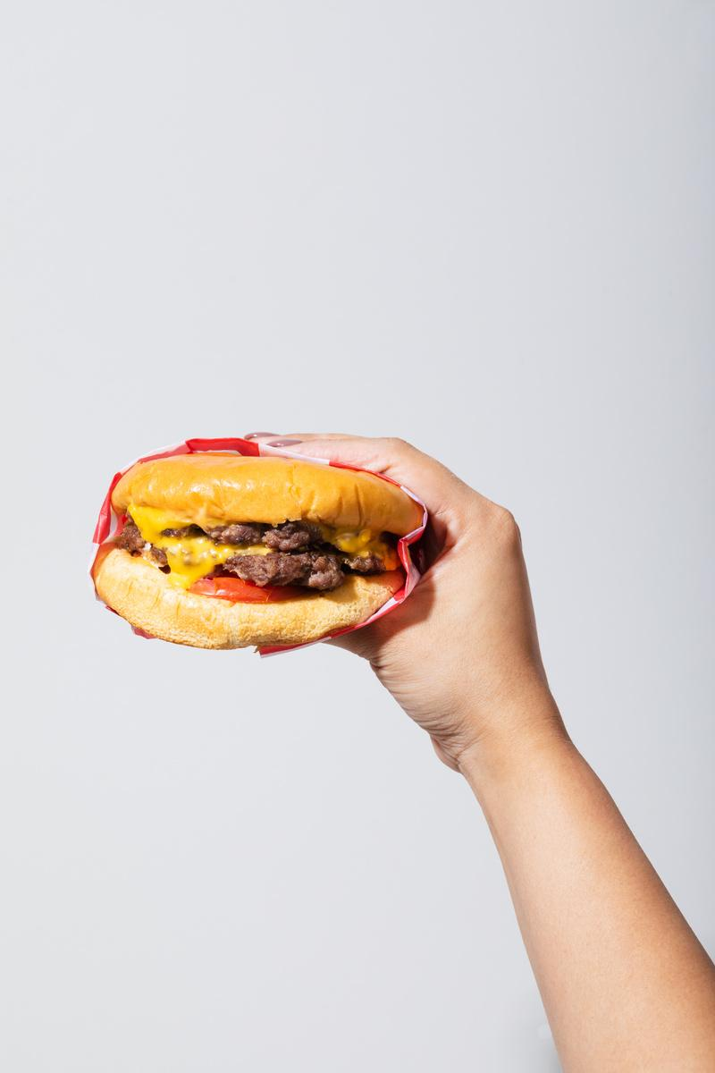
INSPIRING INGREDIENTS
Bread
Different Shapes, Styles or FLavors
Toppings
Multiple Toppings with Complex Flavors and Textures
Meat
Different types of protein such as Beef, Lamb, Pork or Chicken

Slide 14
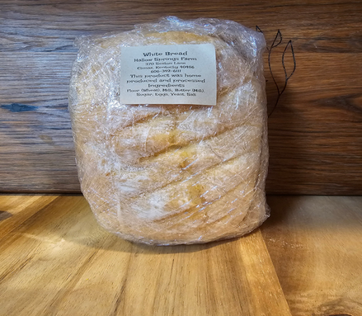
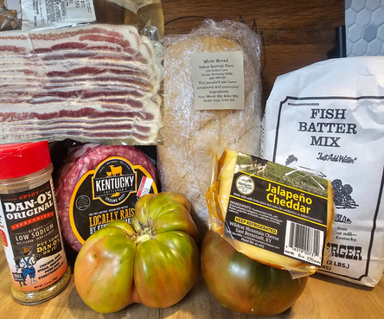
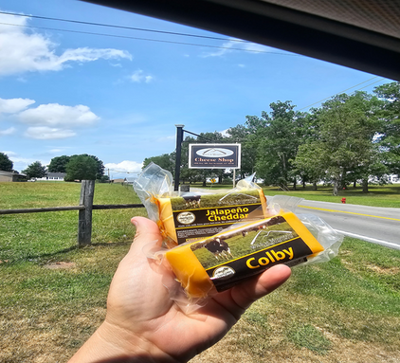
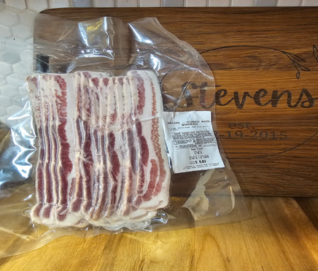
SPOTLIGHT YOUR LOCAL FARMER AND PRODUCTS
Holly Springs Farm
Wilson Farm and Dan O’s
Wildcat Mountain Farmstead Cheeses
Summit Meats
Heirloom Green Tomatoes, Dan O’s Seasoning, KY Beef and Weisenberger Fish Batter
Bacon
Bread Variety
such as Italian Loaves and White Sandwich Bread
Jalapeno Cheddar Cheese

Slide 15
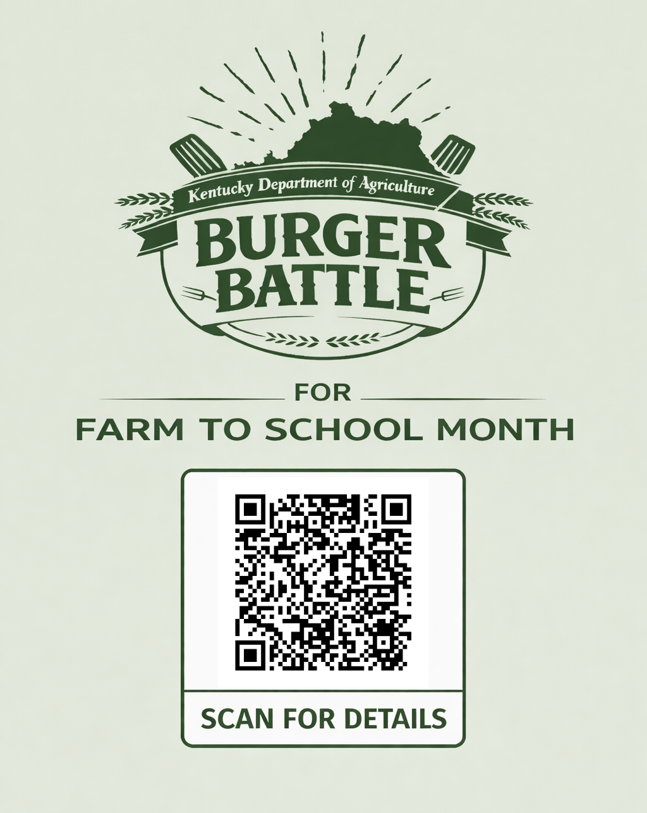


CONTACT US
Chef Shannon Stevens: 502-871-2995
Chef Rebecca Shepherd-Smith: 502-330-7488
Tina Garland: 502-382-7505
shannon.stevens@ky.gov
rebecca.shepherd-smith@ky.gov
tina.garland@ky.gov

Slide 16
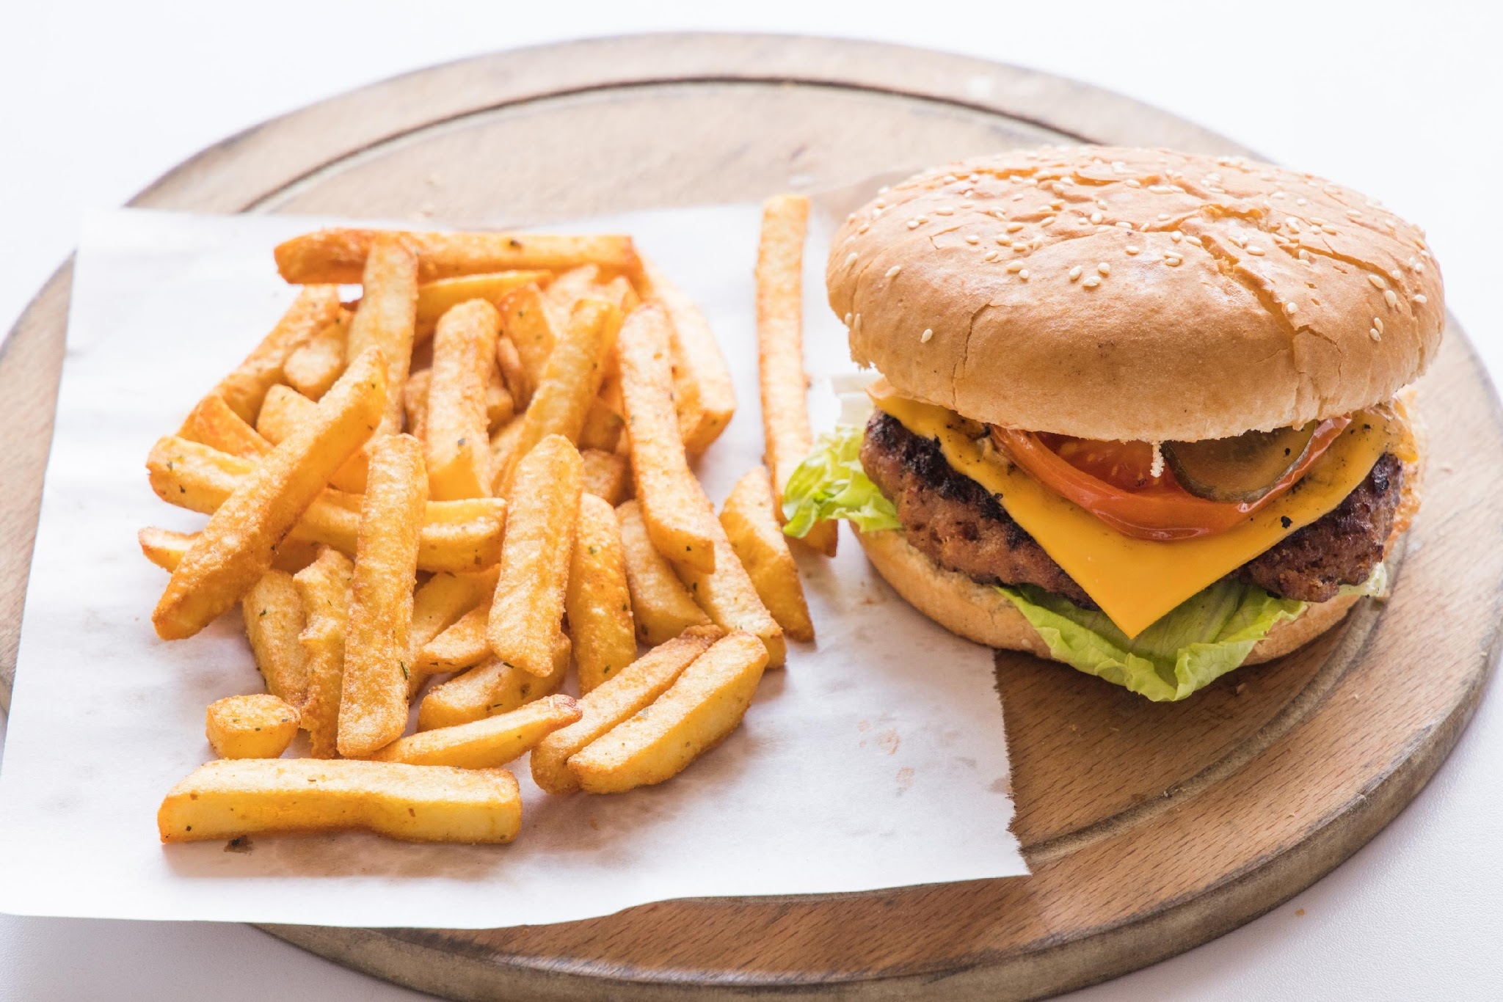
THANK YOU
Good Luck in the Farm to School Month Burger Battle!!
Let the cooking begin!!!

Slide 17
Questions?

Slide 18
USDA Nondiscrimination Statement
In accordance with federal civil rights law and U.S. Department of Agriculture (USDA) civil rights regulations and policies, this institution is prohibited from discriminating on the basis of race, color, national origin, sex (including gender identity and sexual orientation), disability, age, or reprisal or retaliation for prior civil rights activity.
Program information may be made available in languages other than English. Persons with disabilities who require alternative means of communication to obtain program information (e.g., Braille, large print, audiotape, American Sign Language), should contact the responsible state or local agency that administers the program or USDA’s TARGET Center at (202) 720-2600 (voice and TTY) or contact USDA through the Federal Relay Service at (800) 877-8339.
To file a program discrimination complaint, a Complainant should complete a Form AD-3027, USDA Program Discrimination Complaint Form which can be obtained online at: https://www.usda.gov/sites/default/files/documents/ad-3027.pdf, from any USDA office, by calling (866) 632-9992, or by writing a letter addressed to USDA. The letter must contain the complainant’s name, address, telephone number, and a written description of the alleged discriminatory action in sufficient detail to inform the Assistant Secretary for Civil Rights (ASCR) about the nature and date of an alleged civil rights violation. The completed AD-3027 form or letter must be submitted to USDA by:
mail:
U.S. Department of Agriculture
Office of the Assistant Secretary for Civil Rights
1400 Independence Avenue, SW
Washington, D.C. 20250-9410; or
fax:
(833) 256-1665 or (202) 690-7442; or
email:
Program.Intake@usda.gov
This institution is an equal opportunity provider.

