Slide 1
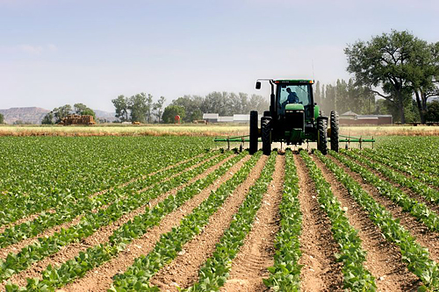
Know your local farmers
and what they do for you
Notes:
Bell Ringer/Class Opener:
Slide 1 – write on the board or ask students to “Describe what ‘Kentucky Farmer’ means to you.” Have them put this away and save for later use.

Slide 2



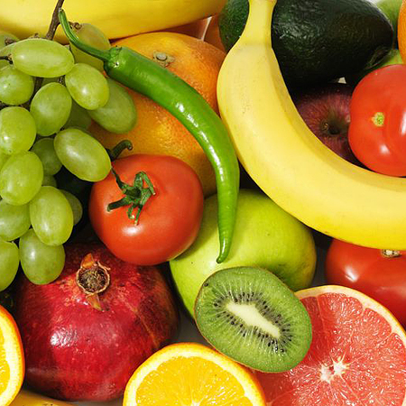
What is the definition
of a consumer product?
Notes:
Slide 2
What is the definition of a consumer product?
Give students time to come up with their own answers. Have them write just what they think not the dictionary definition.
Discuss student answers.

Slide 3




Consumer Products?
Generally any tangible personal property for sale that is used for personal, family, or household non-business purposes.
Notes:
Slide 3
Use activity sheet 1-1 “What do Farmers Have to Do With It?”
Use handout 1-1 “Agricultural Content of Common Household Consumer Products.”
Discuss consumer products and farmer involvement and ask which type of farmer helped produce the products.

Slide 4
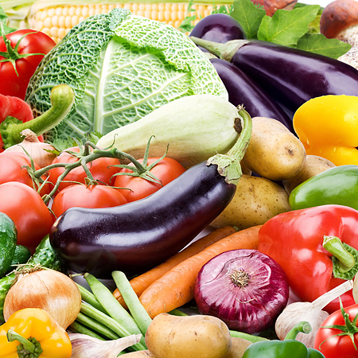
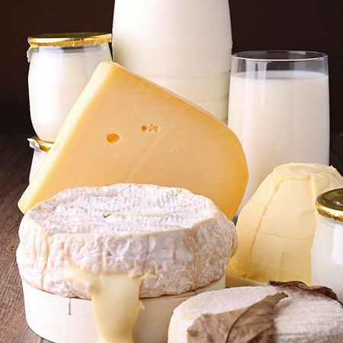
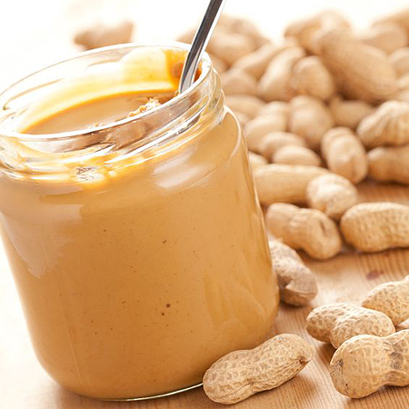
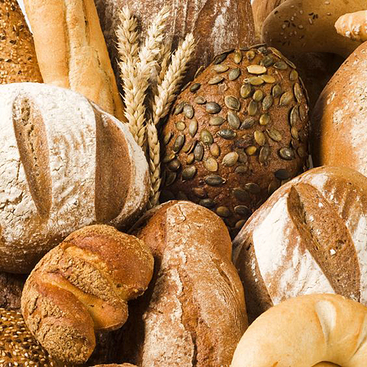
Focus on Foods
Notes:
Slide 4
This is a basic MyPlate review. The five major food groups: grains, vegetables, fruits, dairy, and proteins. Discuss which foods belong in each group of MyPlate.
Choose from one of the two MyPlate activities and have students complete: (1) MyPyramid worksheet NEP – 201C (2) Log on to http://www.MyPlate.gov
Use activity sheet 1-2 “Focus on Food & Farming.”
Use activity sheet 1-4 “Hometown City Activity.”

Slide 5
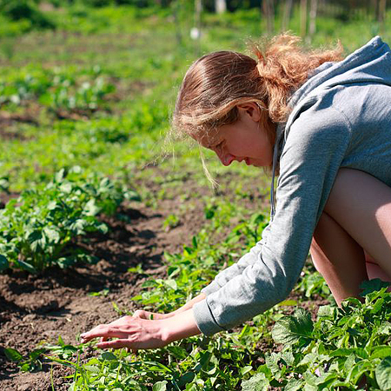
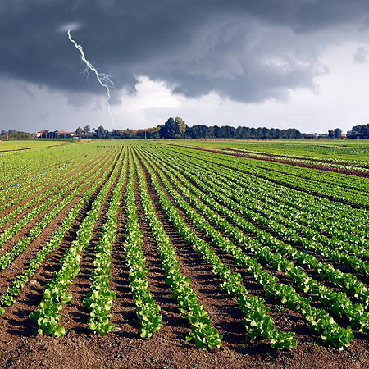
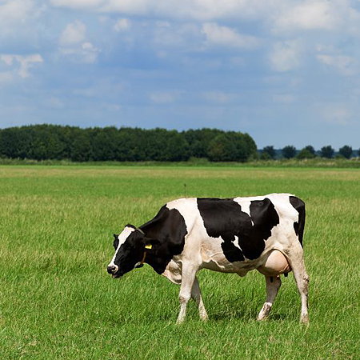

Farming, How Hard Could It Be?
Notes:
Slide 5
Farming skills and knowledge.
Have students list all the occupations and skills they think are associated with farming.
If “The Many Faces of a Farmer” video is available, have students watch the video and write down what occupations and skills they see in the video. (If video is not available use example occupations and skills to discuss how these are associated with farming.)
Use activity sheet 1-5 “What’s A Farmer To Do?”

Slide 6

Created by
Diana Drury
University of Kentucky Cooperative Extension Nutrition Education Program
Jackie Walters
University of Kentucky Cooperative Extension Nutrition Education Program
Tina Garland
Kentucky Department of Agriculture
Educational programs of Kentucky Cooperative Extension serve all people regardless of race, color, age, sex, religion, disability, or national origin.

